Slide 1

CSN-291 OOAD Project
DIGITAL Assistant FOR Library Group: 13
Sri Vardhan(20114051)
Mahibabu(20114058)
Vasavi(20114064)
Sisir Kumar Padhi(20114092)
Sai Kumar(20114098)

Slide 2
Problem Description
Here we are trying to help the students to maintain the track of the books taken from the library and, also their due dates along with fine.
Along with the student, we also help librarian to maintain the availability status of the books regularly and, also to register and monitor the students.

Slide 3
Key Features of the Website:
Login of users
User include:
Student
Librarian
Administration of u
The user can login with registered user name and password.
Registering a student :
A student can send a request to the librarian for registration.

Slide 4
Key Features of the Website:
Student Home page:
After login it opens up to student home page where he can find the below option
View profile – he can view and edit his profile
View taken books – he can read the list of books taken by him and also their due dates
Search / Add a book – This help to search and add book to his book list

Slide 5
View total fine – Fine of each book and their over due days along with total fine.
Request for extension – The student can extend the due date of book if it is not reserved.

Slide 6
Key Features of the Website:
Librarian Home page:
After login it opens up to librarian home page where he can find the below option
View profile – he can view and edit his profile
Add student – Can register new student
View register request – All the register requests are displayed and librarian can delete / accept requests

Slide 7
Display all books – Lists of all the books is displayed along with availability status and delete a book option.
Add a new book copy – Can add a book copy or new book along with details.
Verify returned book – Returned book is made available to all the student
Remove Student – Registered student can be removed

Slide 8
Tools and Technology used
ArgoUML / Lucid chart
Python – Backend
Django extension – For Dynamic Webpage
Bootstrap/ CSS – Front-end Styling
HTML – Front-end

Slide 9
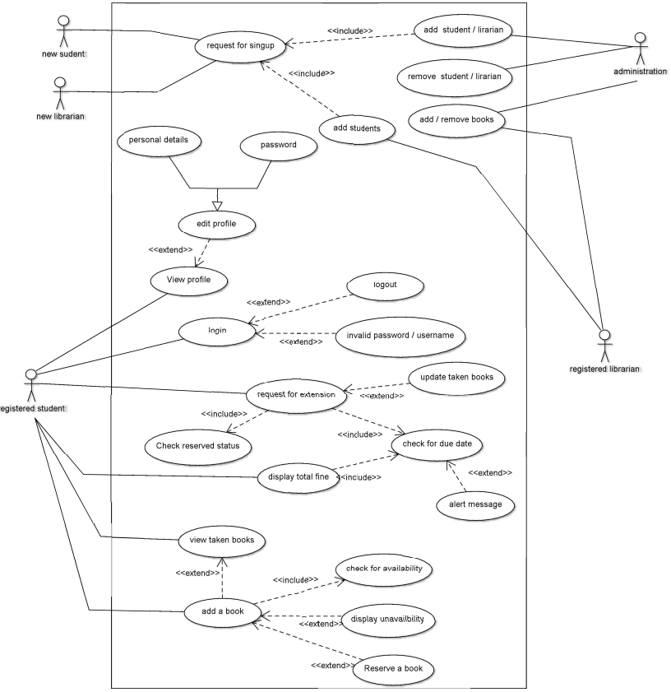
Use Case Diagram

Slide 10
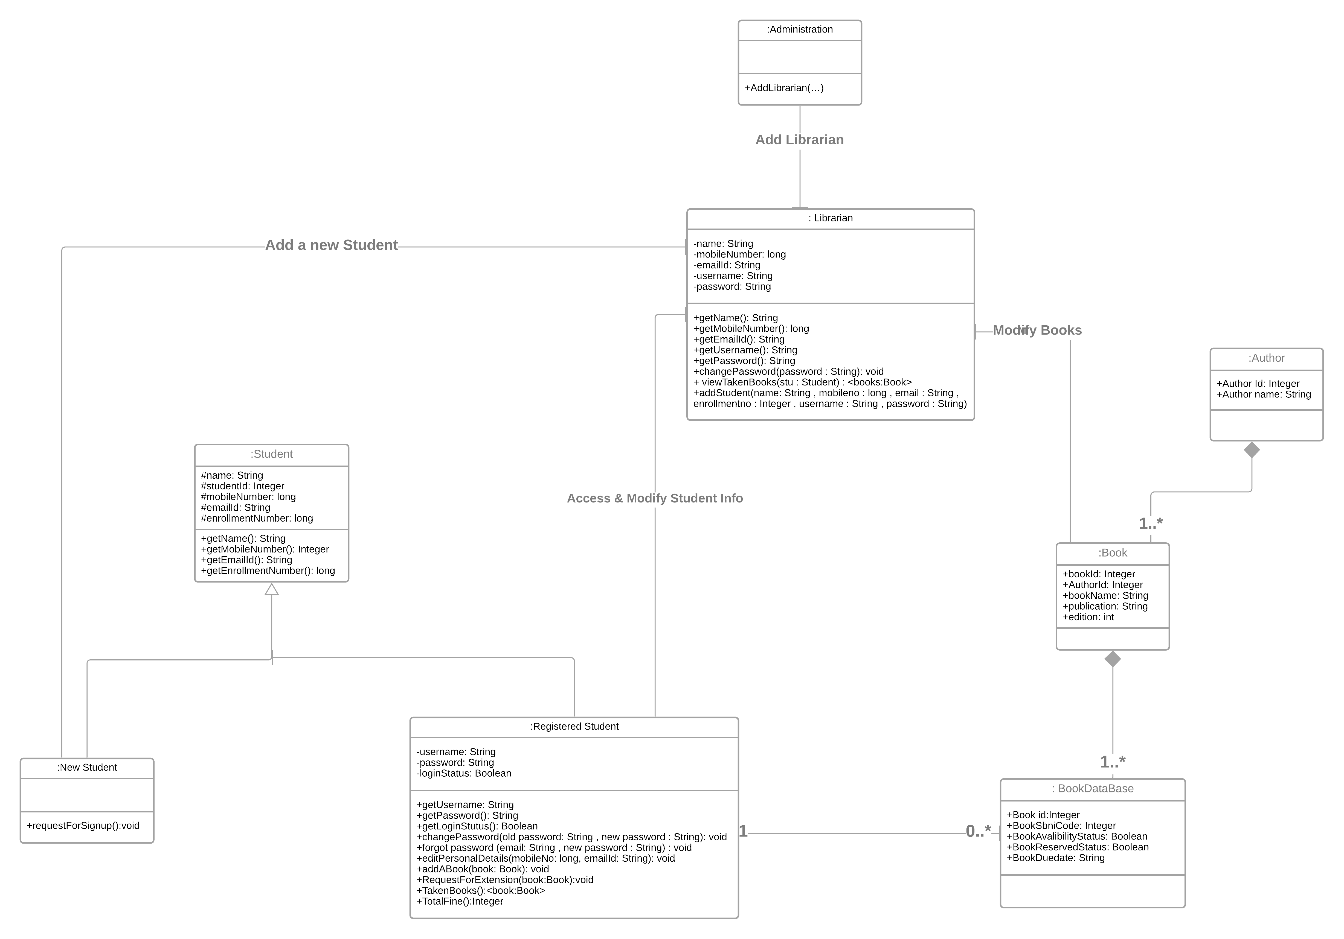
Class Diagram

Slide 11
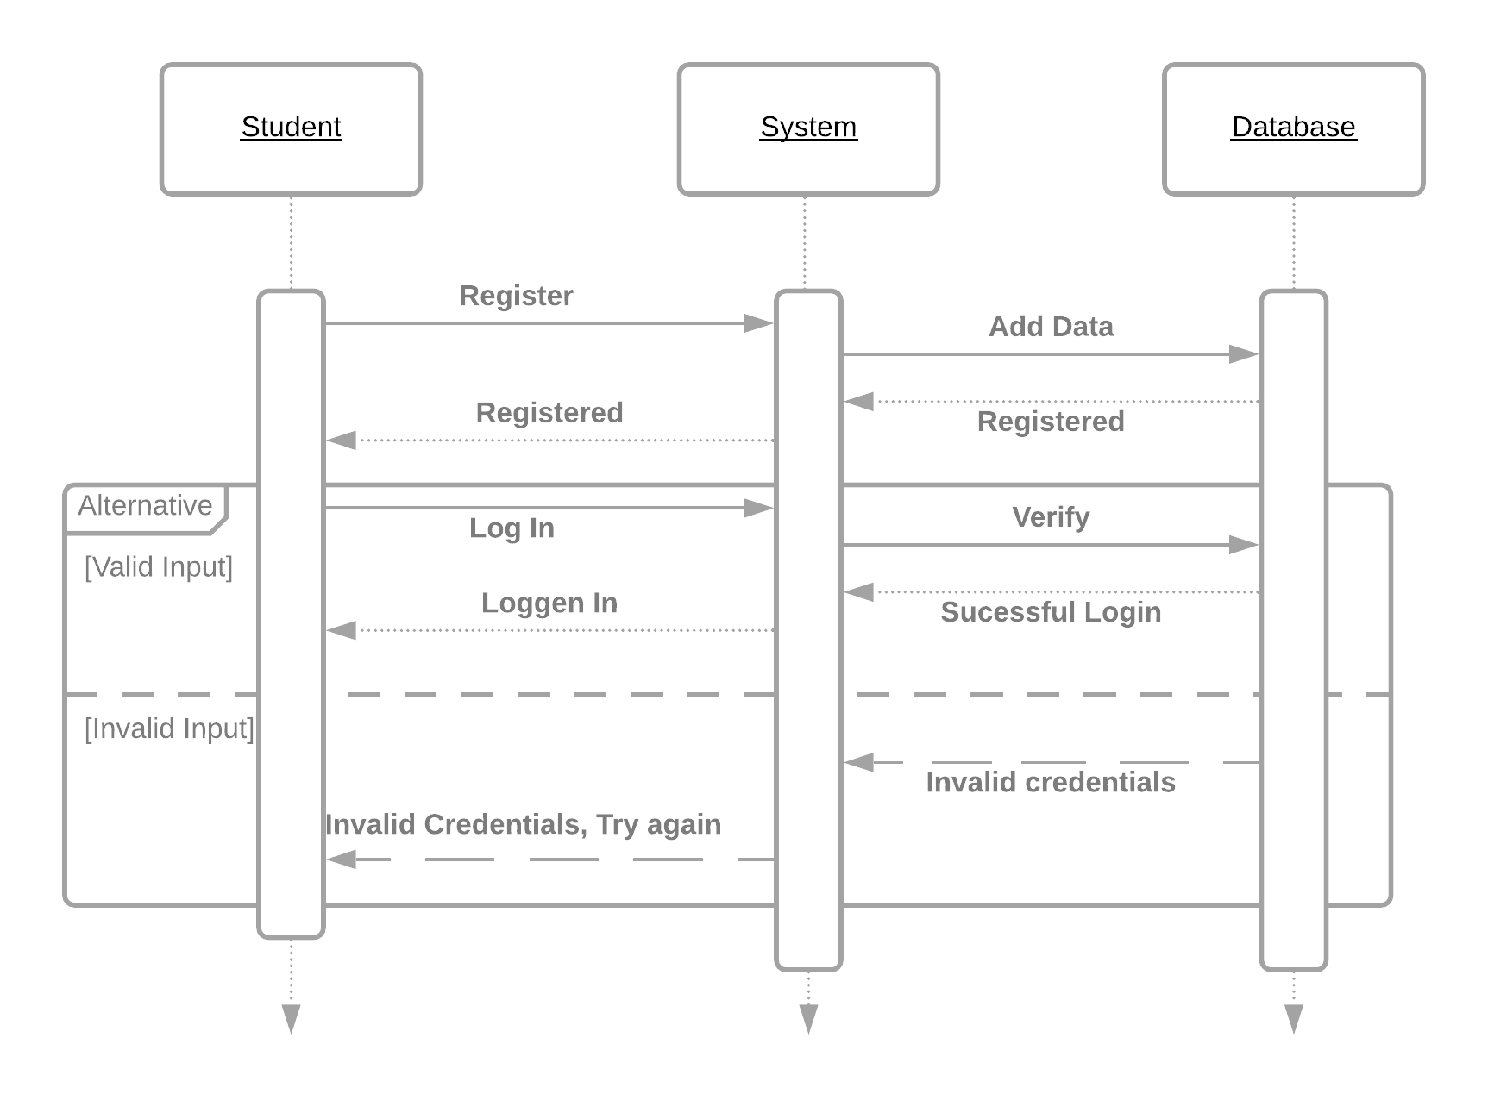
LOGIN AND REGISTRARTION
Sequence Diagram

Slide 12
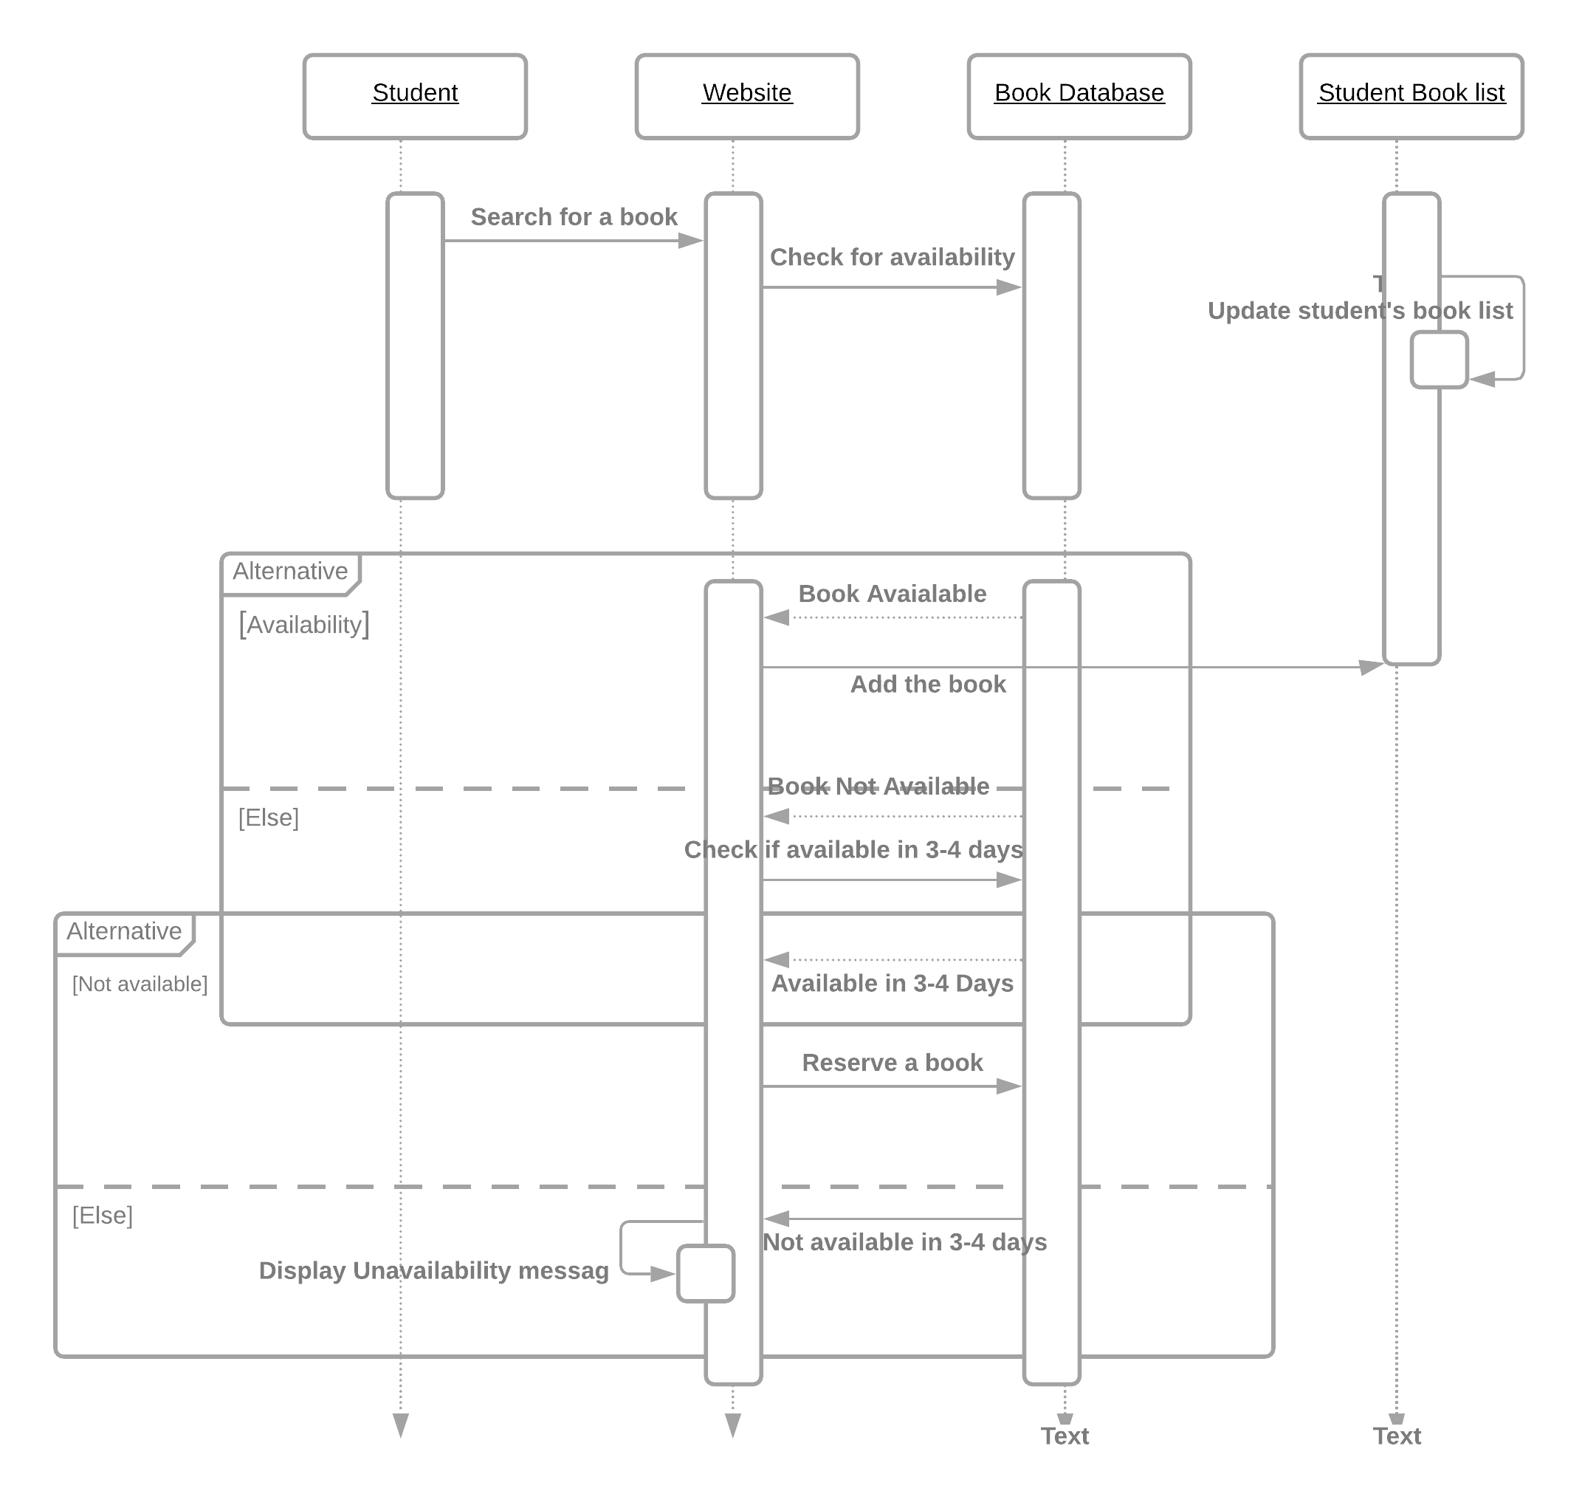
ADD A BOOK BY STUDENT

Slide 13
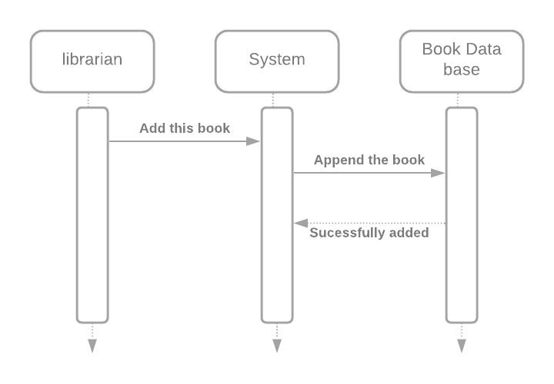
ADD A BOOK BY LIBRARIAN

Slide 14
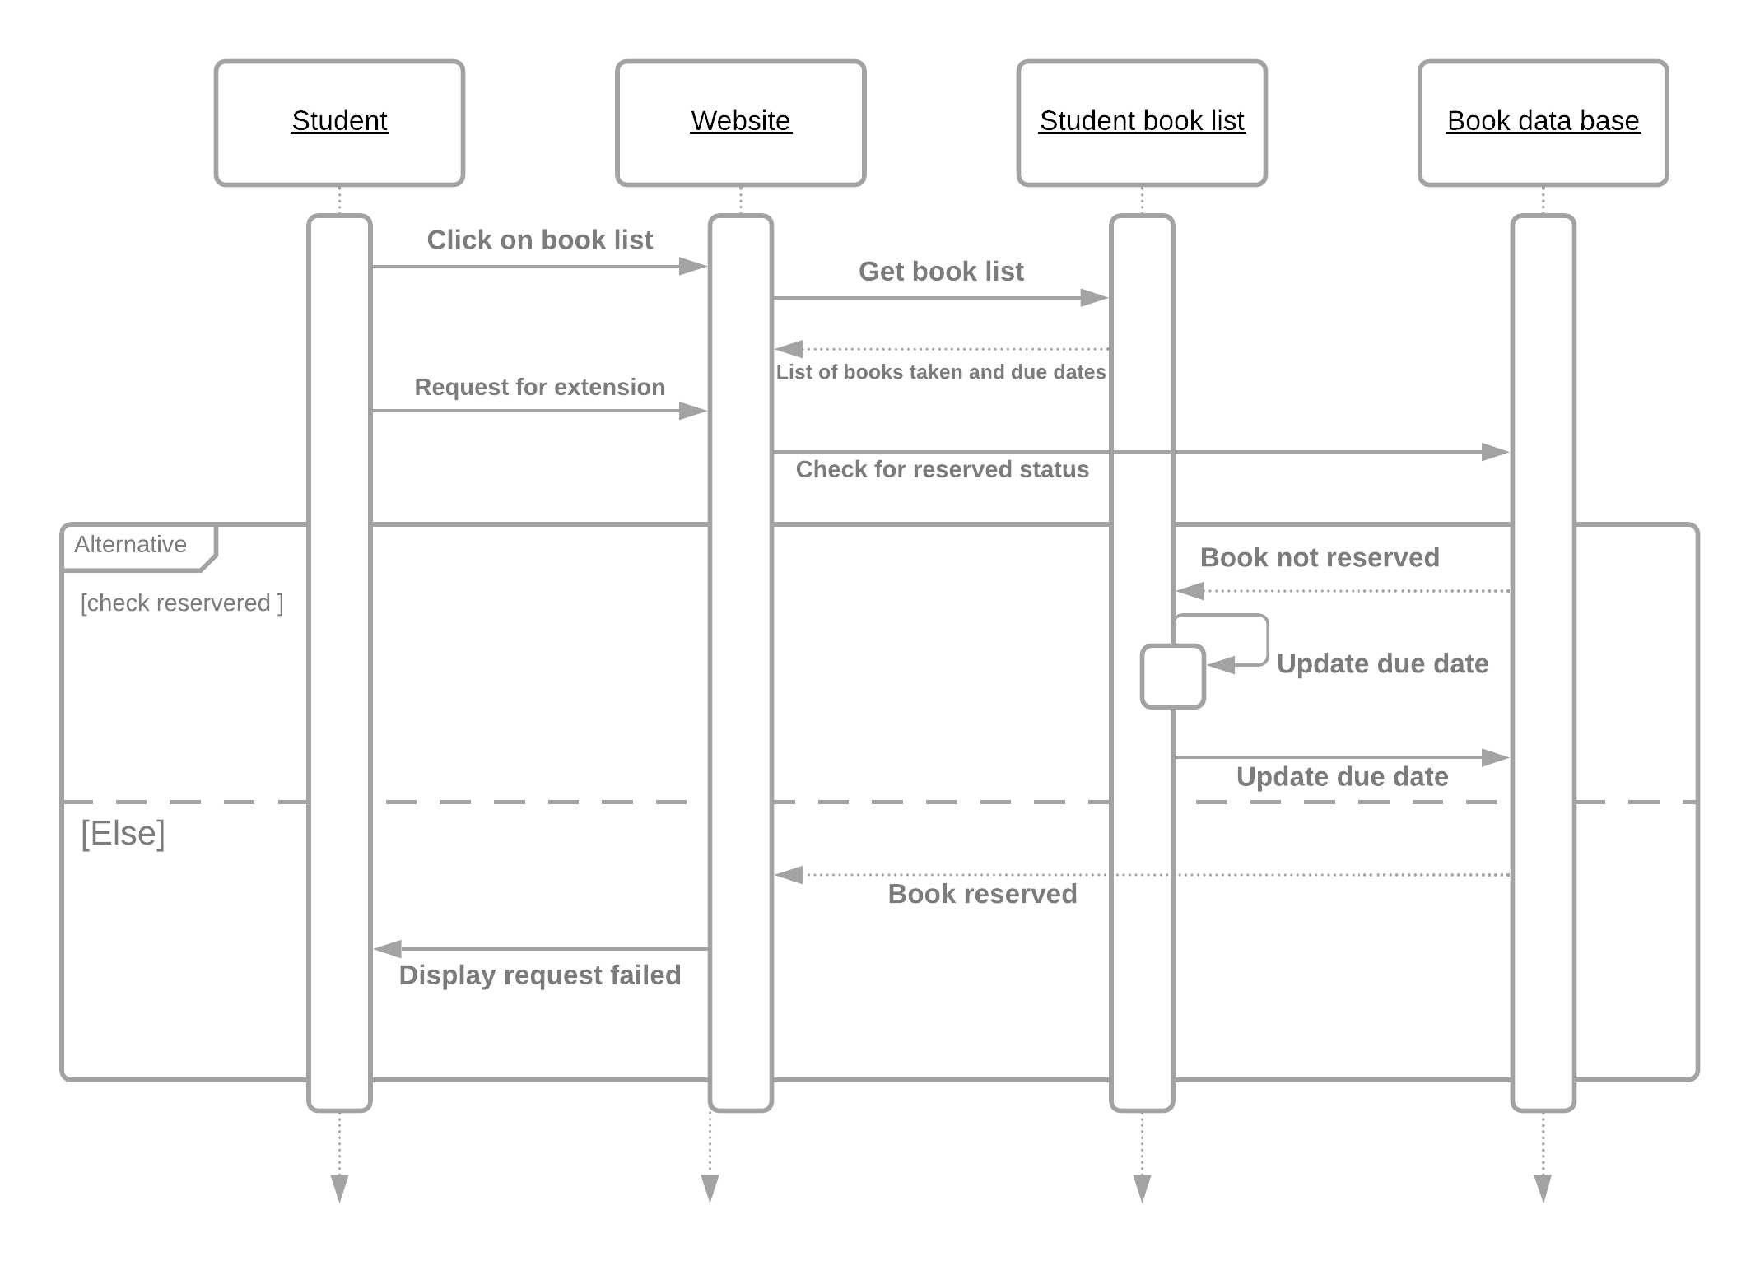
OPTION FOR EXTENSION

Slide 15
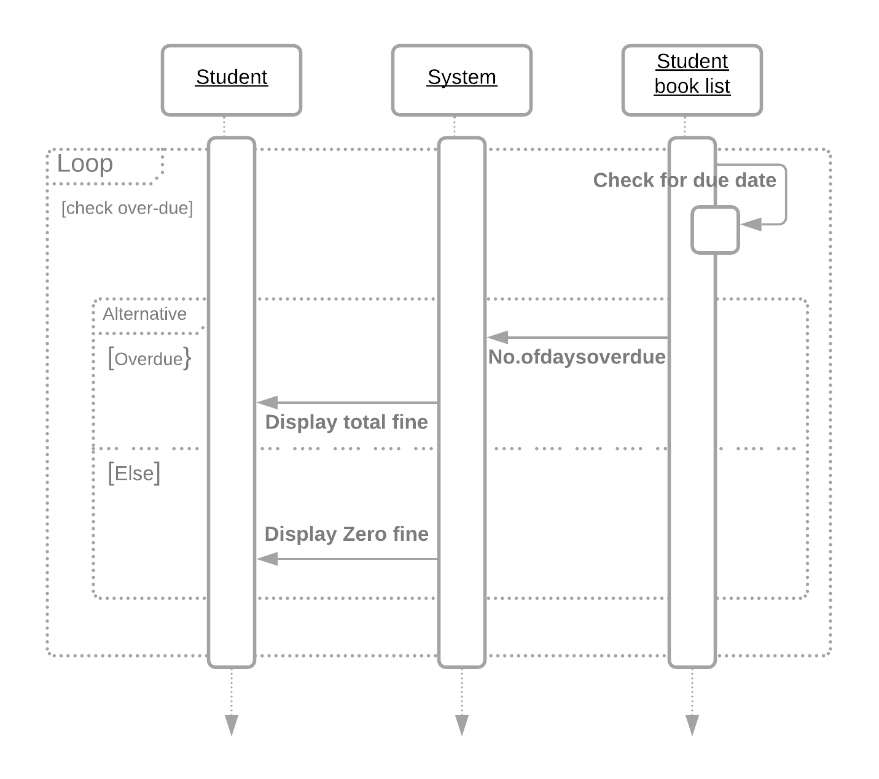
VIEW FINE

Slide 16
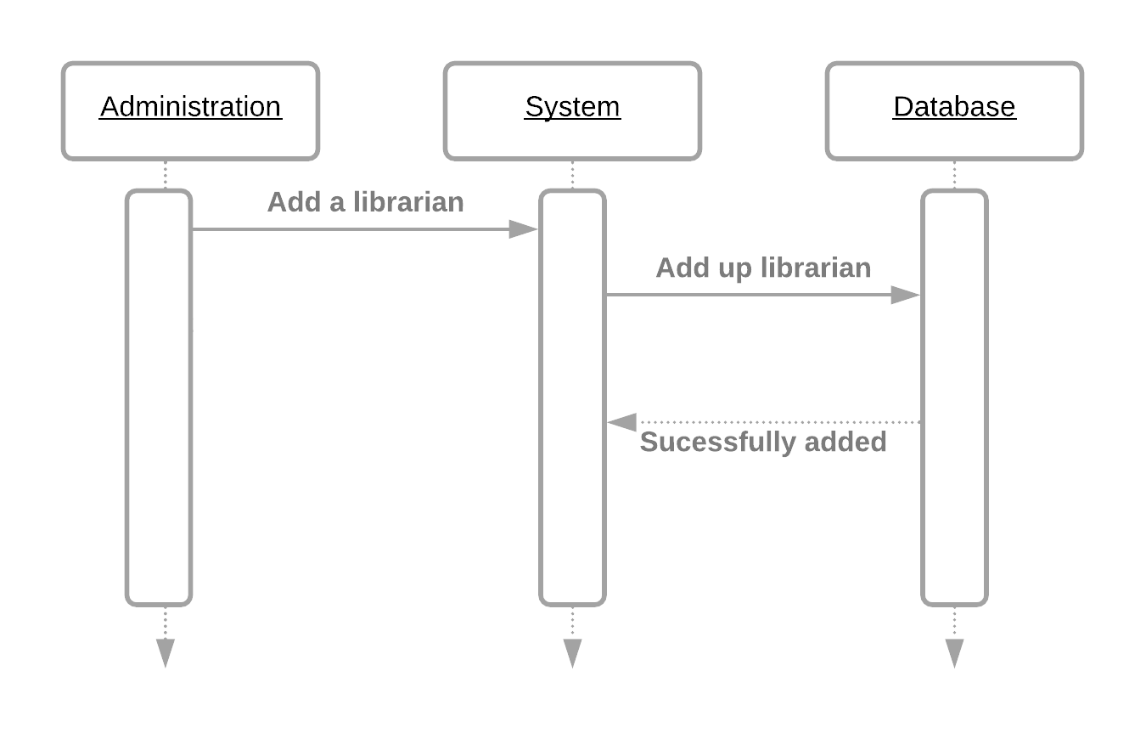
ADD LIBRARIAN BY ADMINSTRATOR

Slide 17
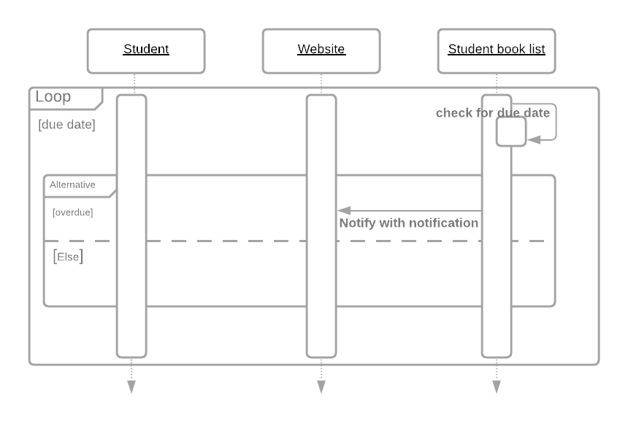
ALERT NOTIFICATIONS

Slide 18


Digital Assistant for Library Demo

Slide 19
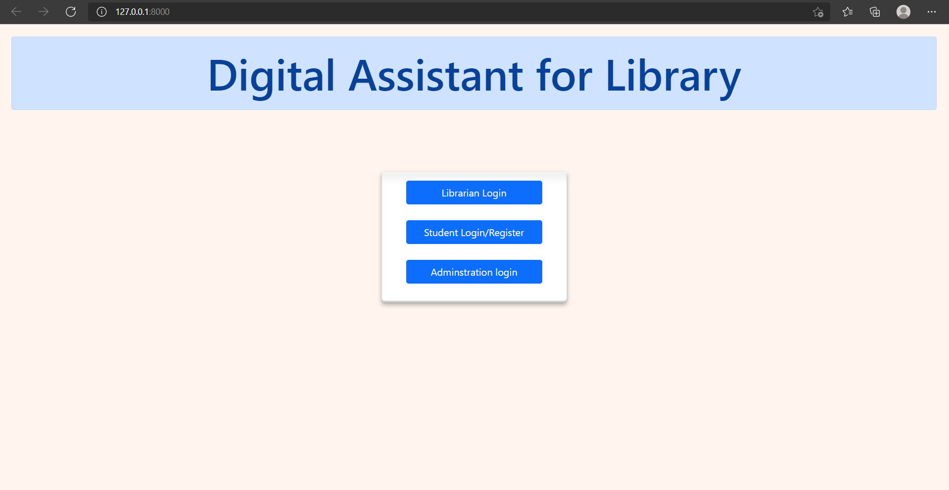

Slide 20
Student home page

Slide 21
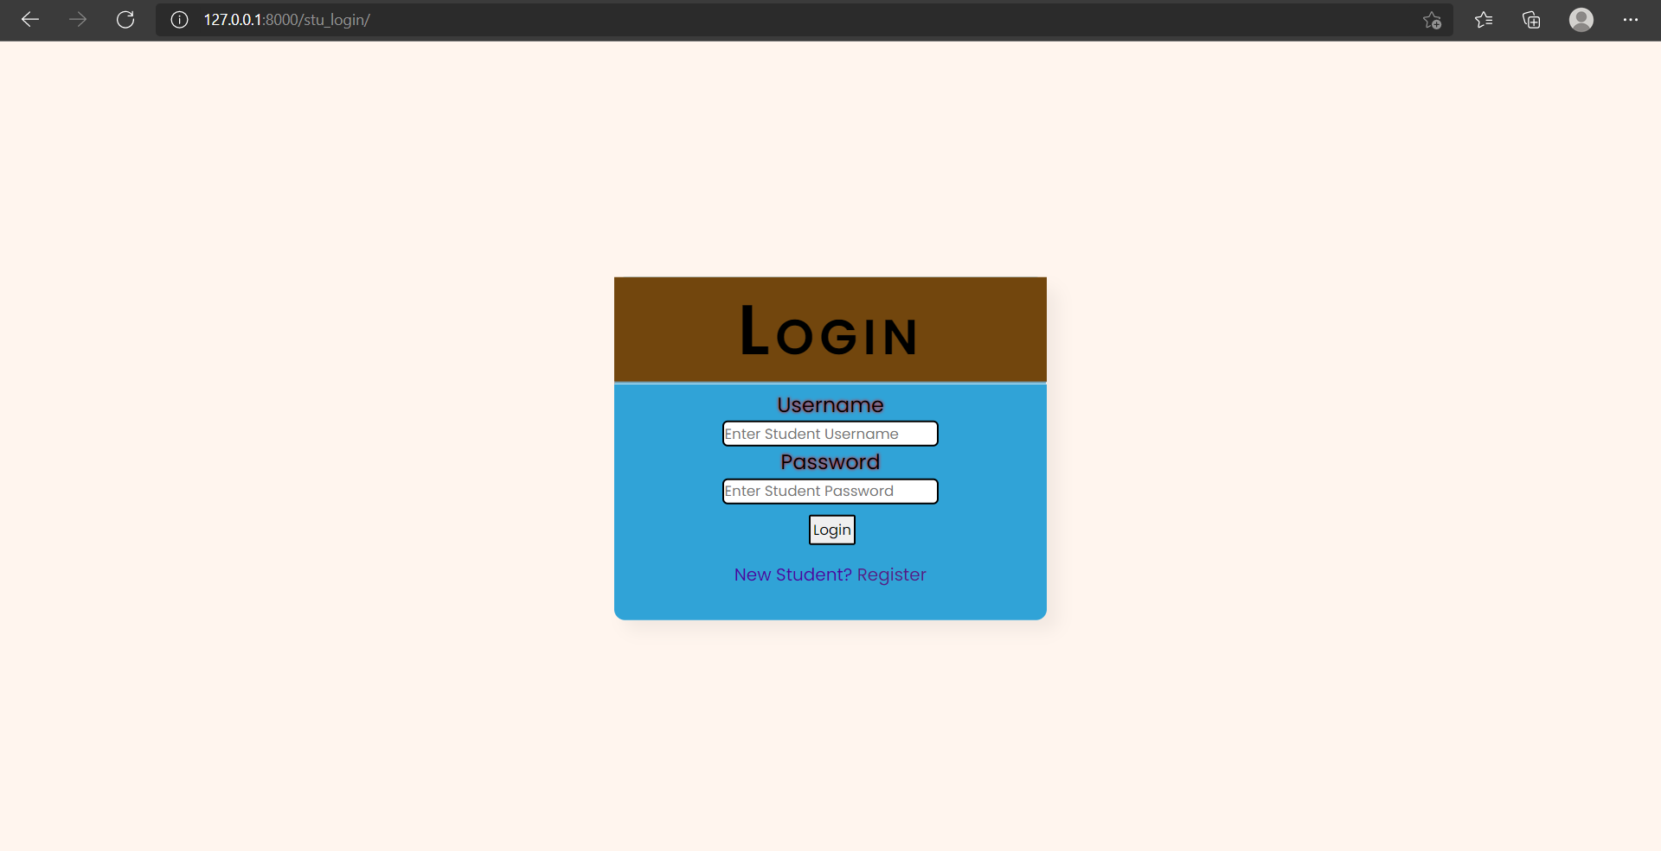

Slide 22
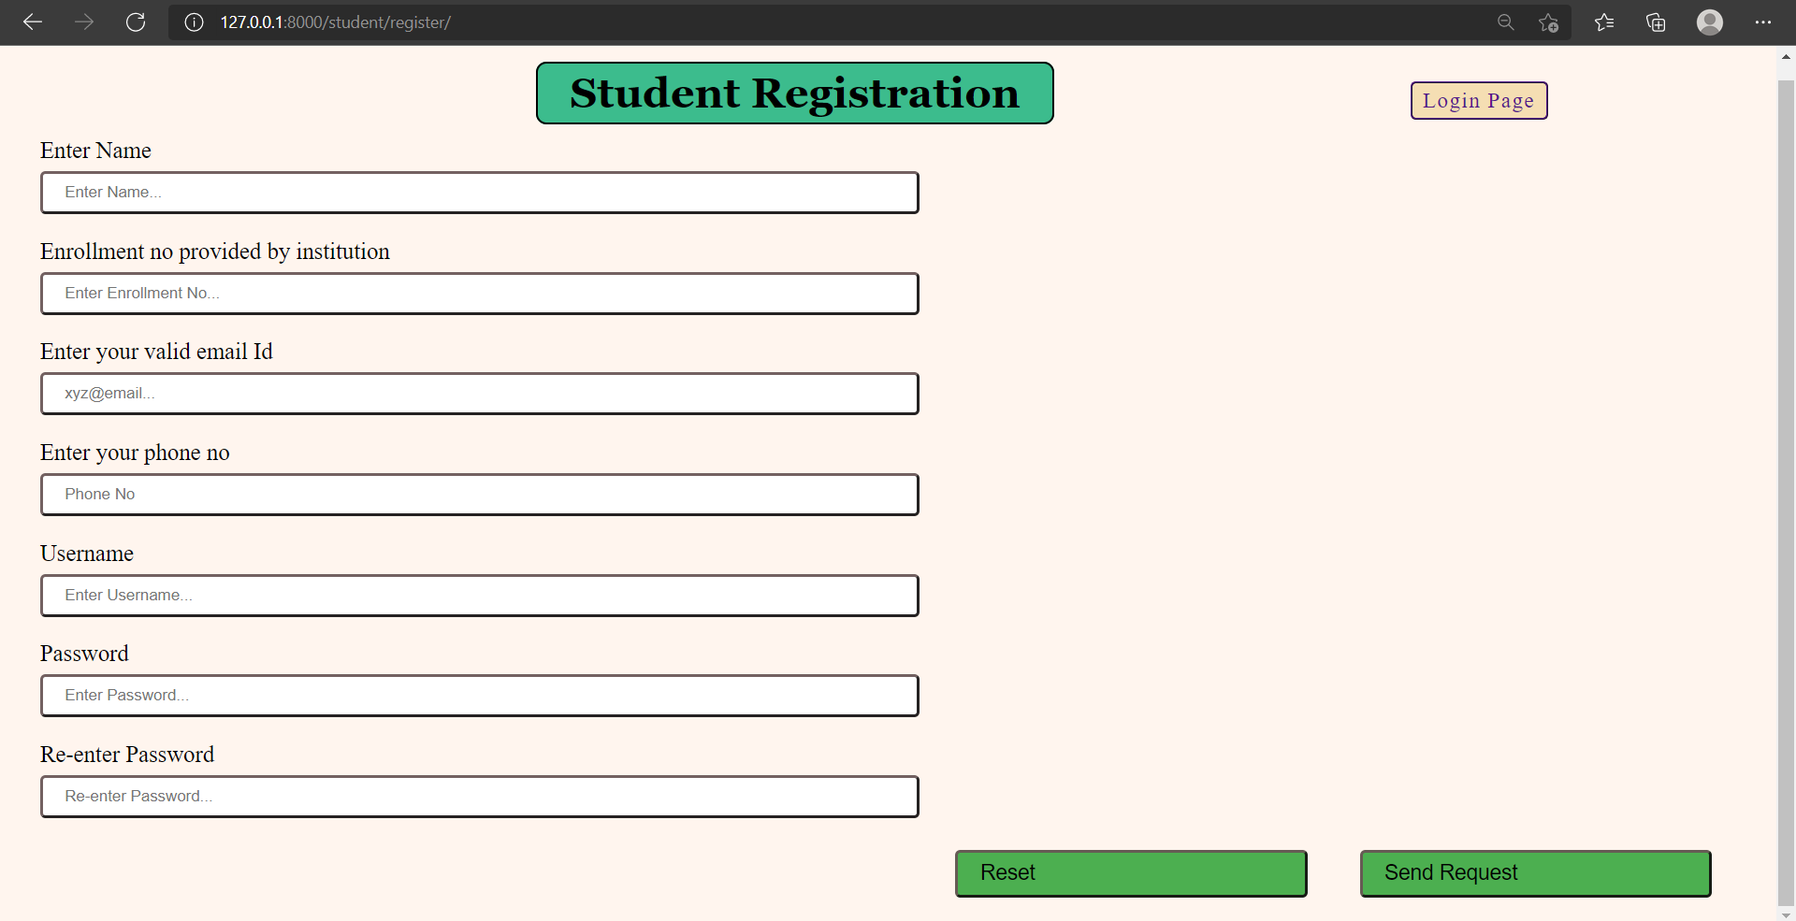

Slide 23
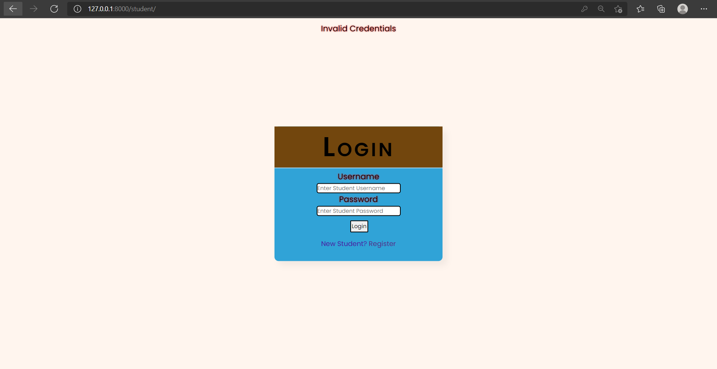

Slide 24
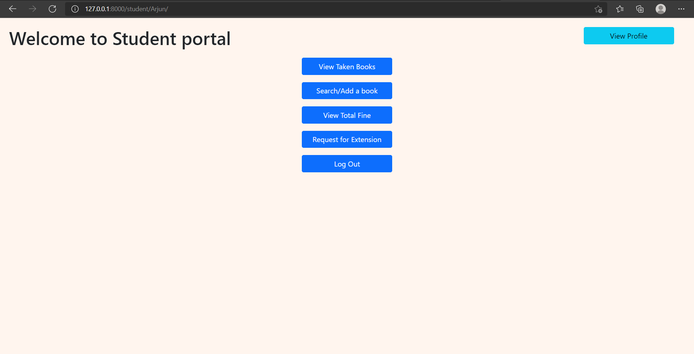

Slide 25
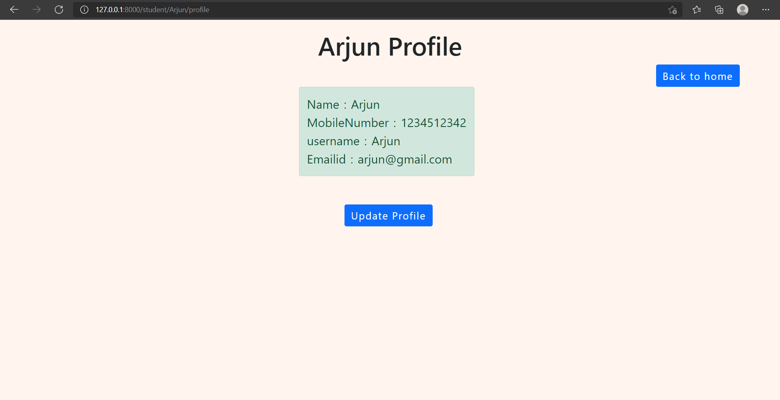

Slide 26
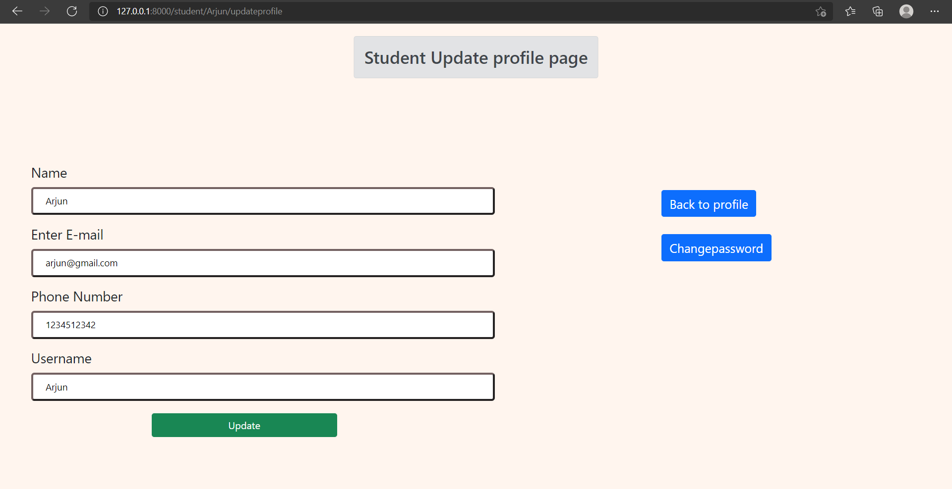

Slide 27
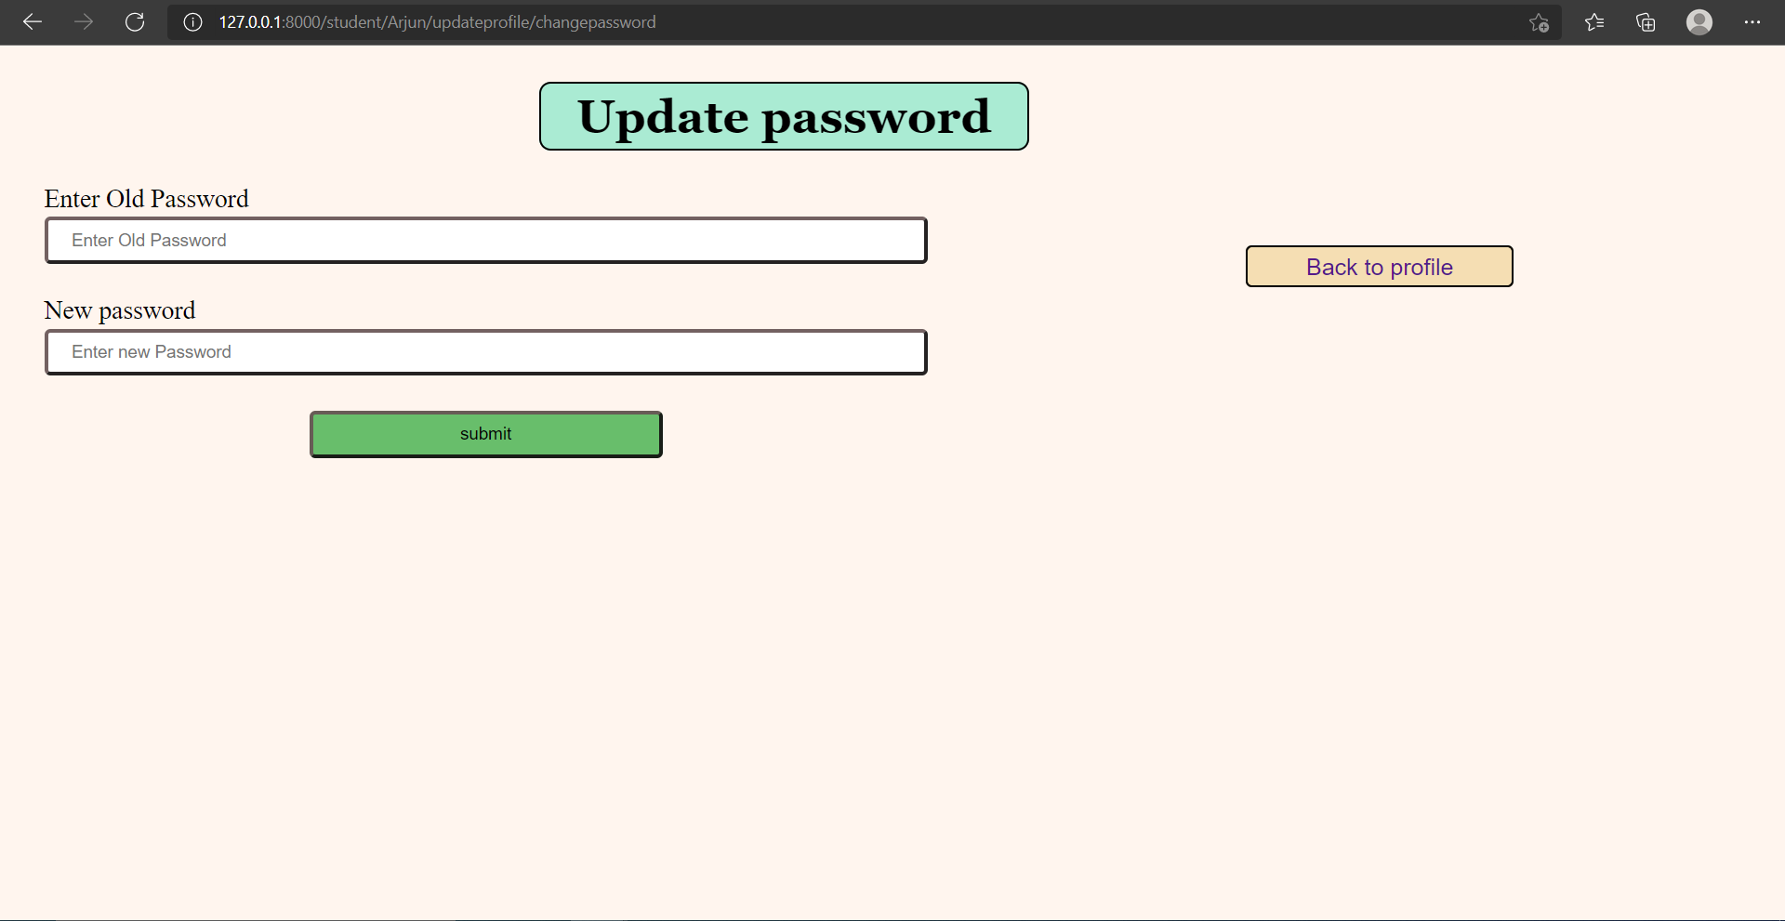

Slide 28
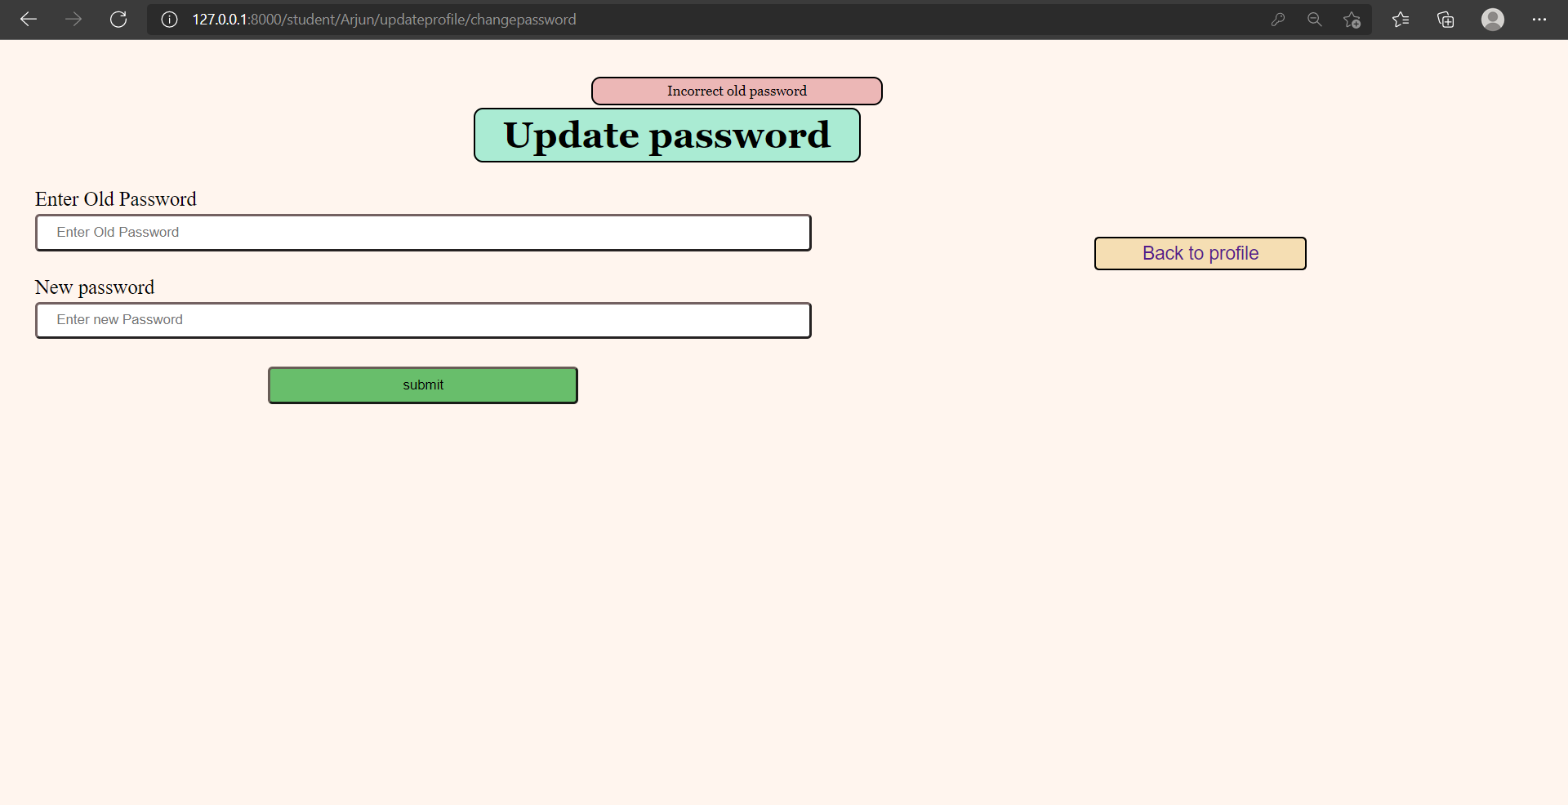

Slide 29
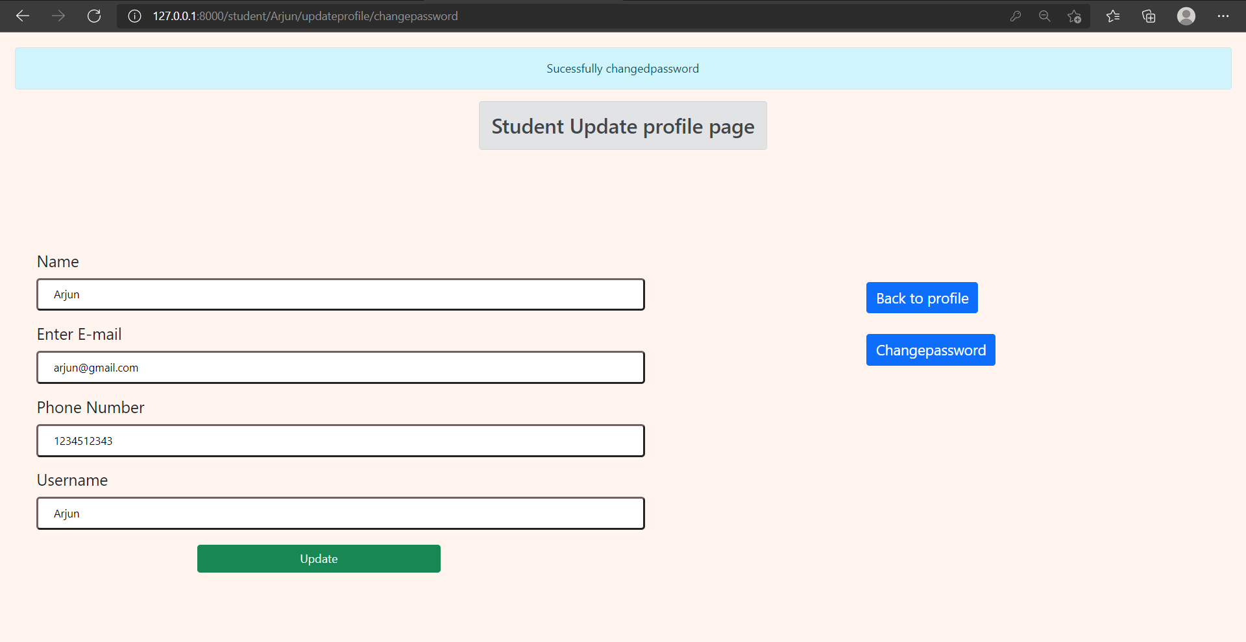

Slide 30
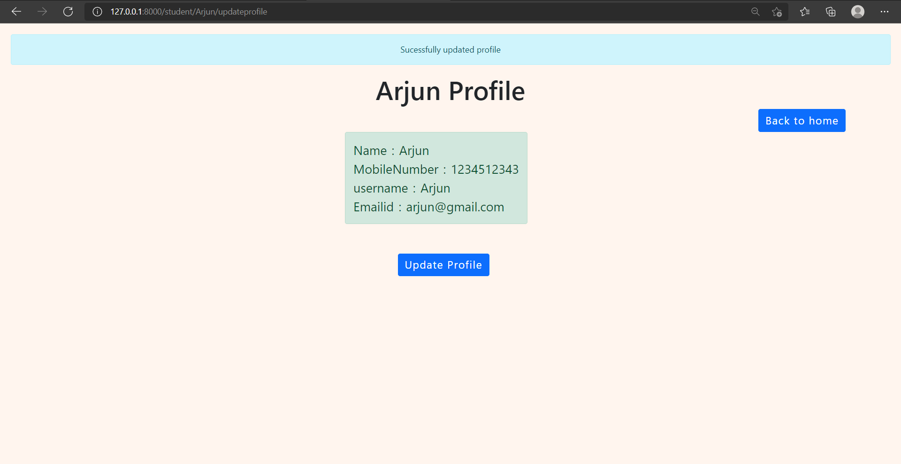

Slide 31
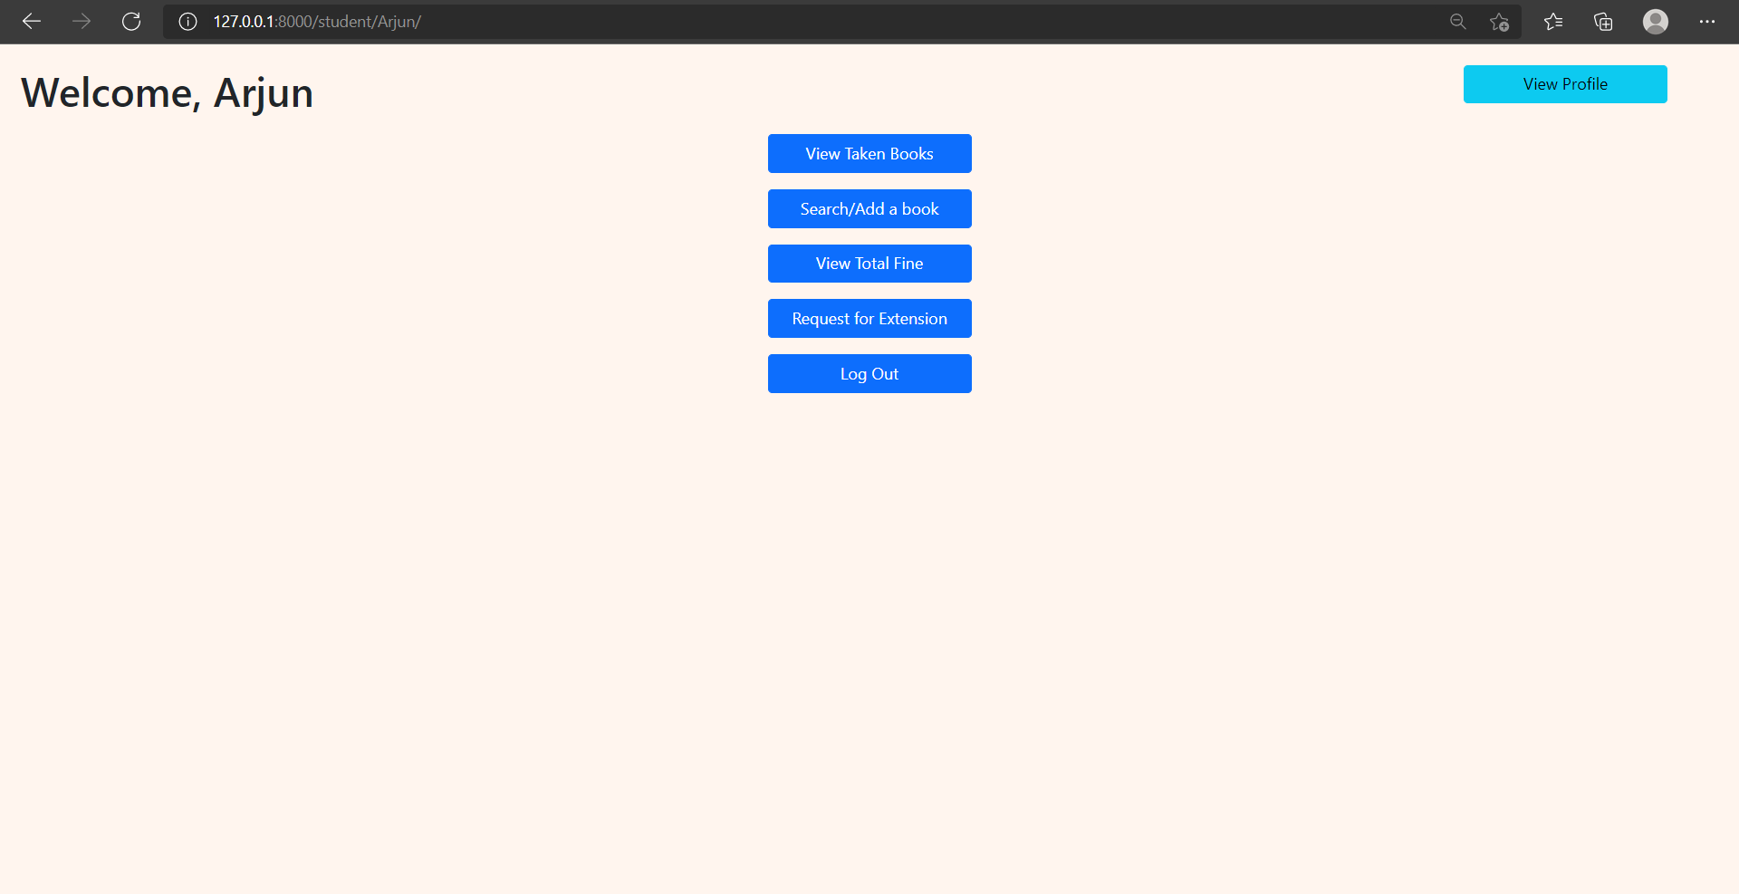

Slide 32
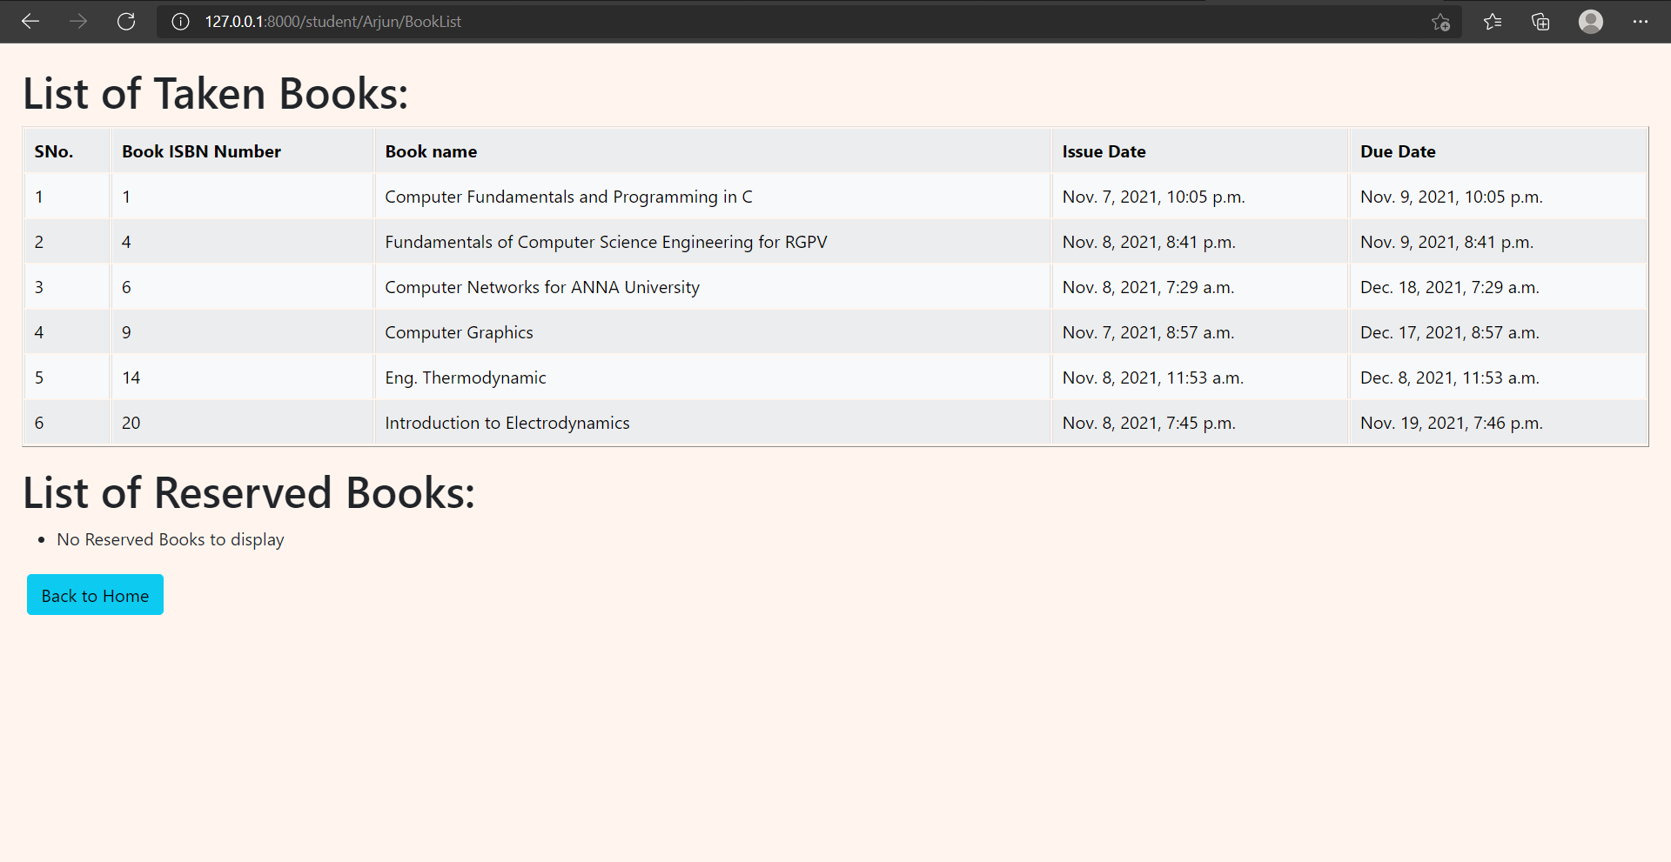

Slide 34
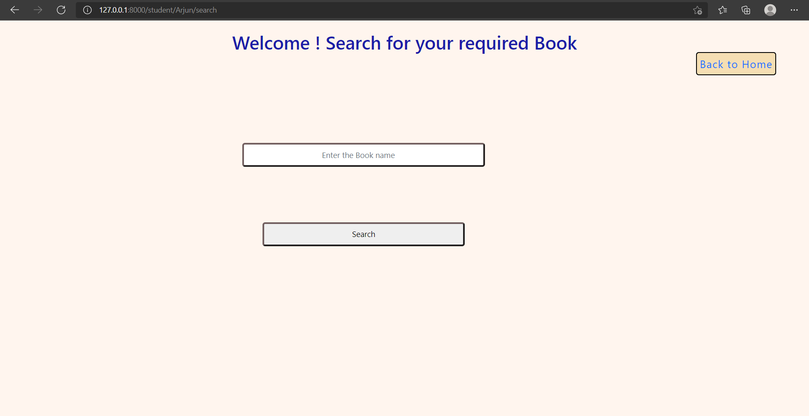

Slide 35
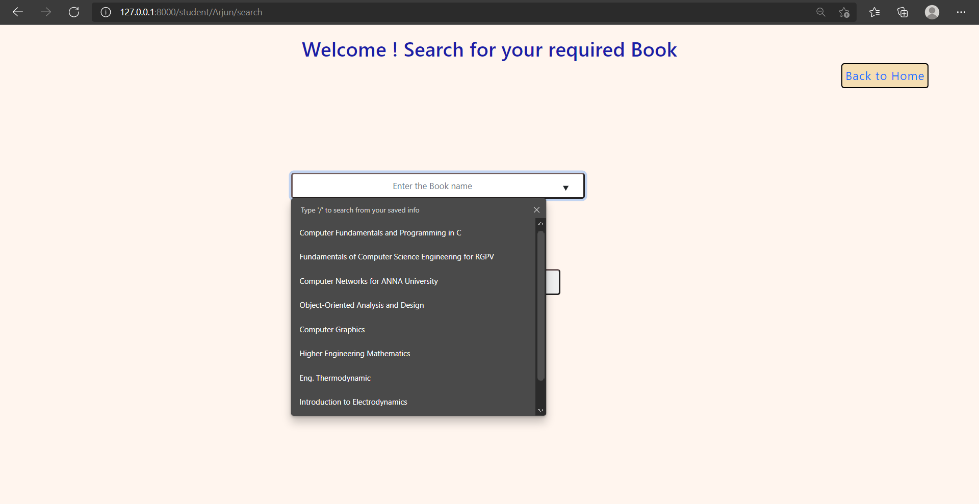

Slide 36
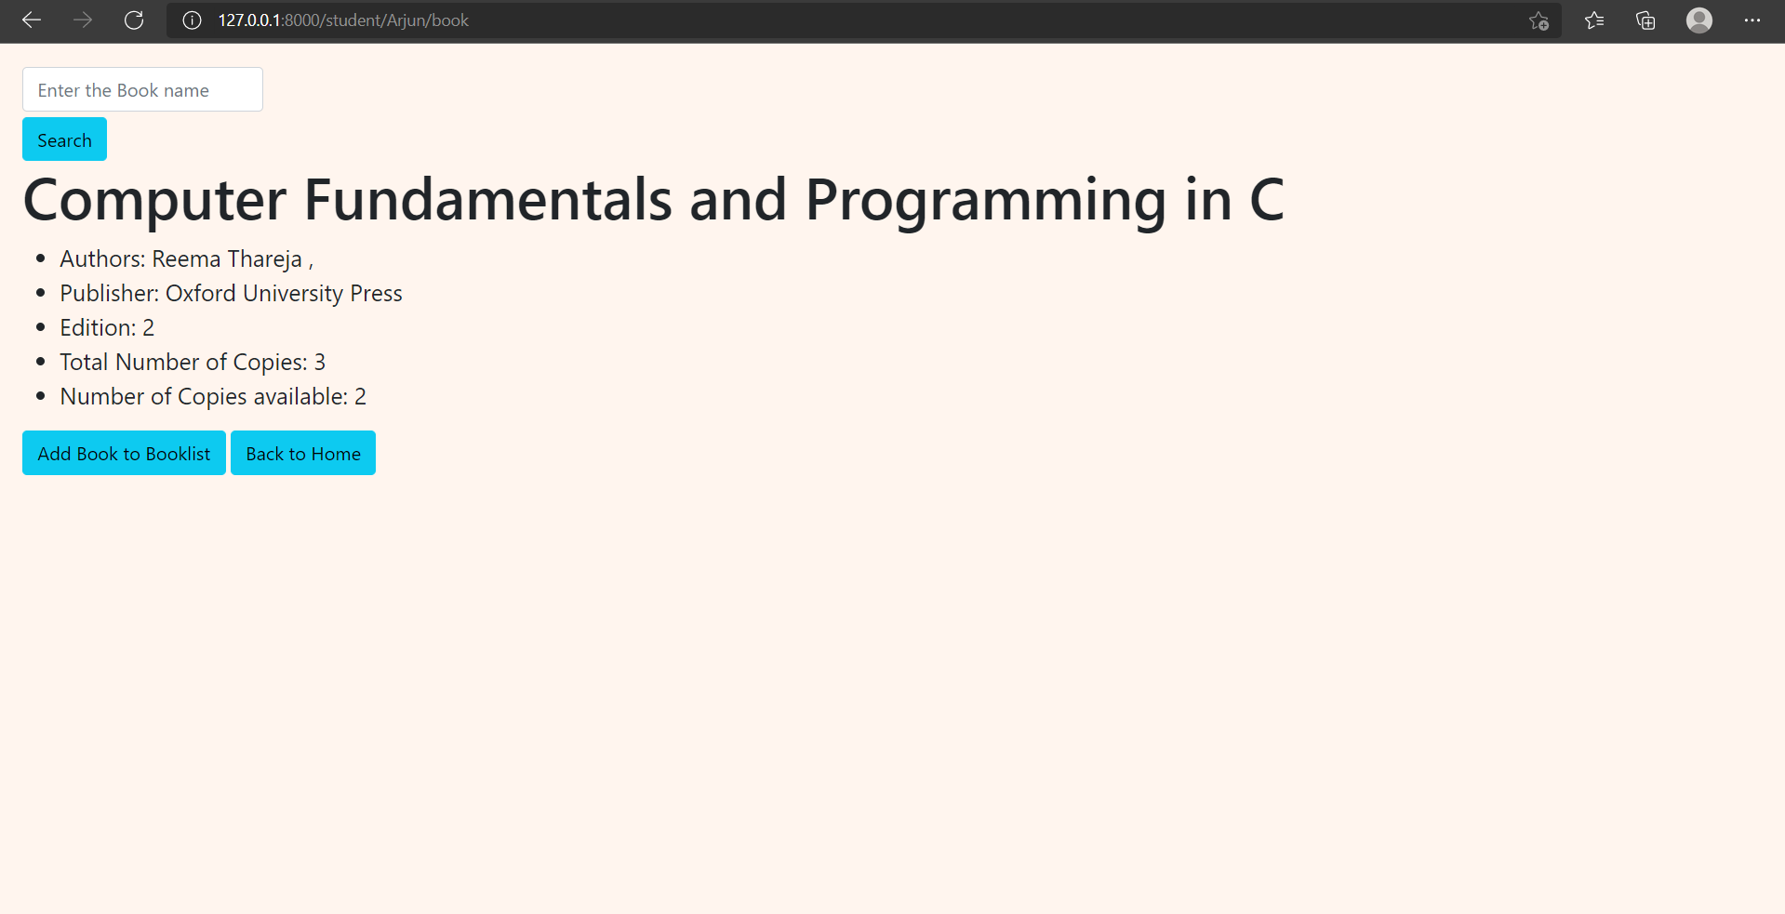

Slide 37
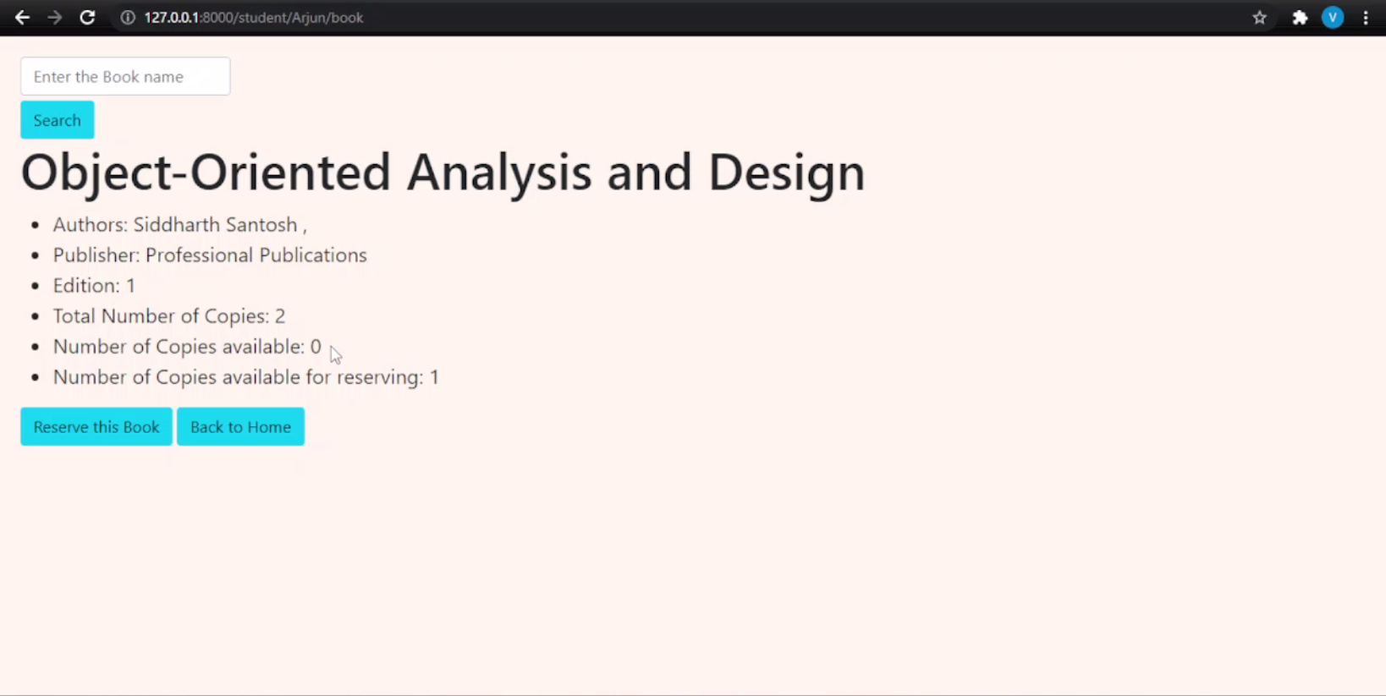

Slide 38
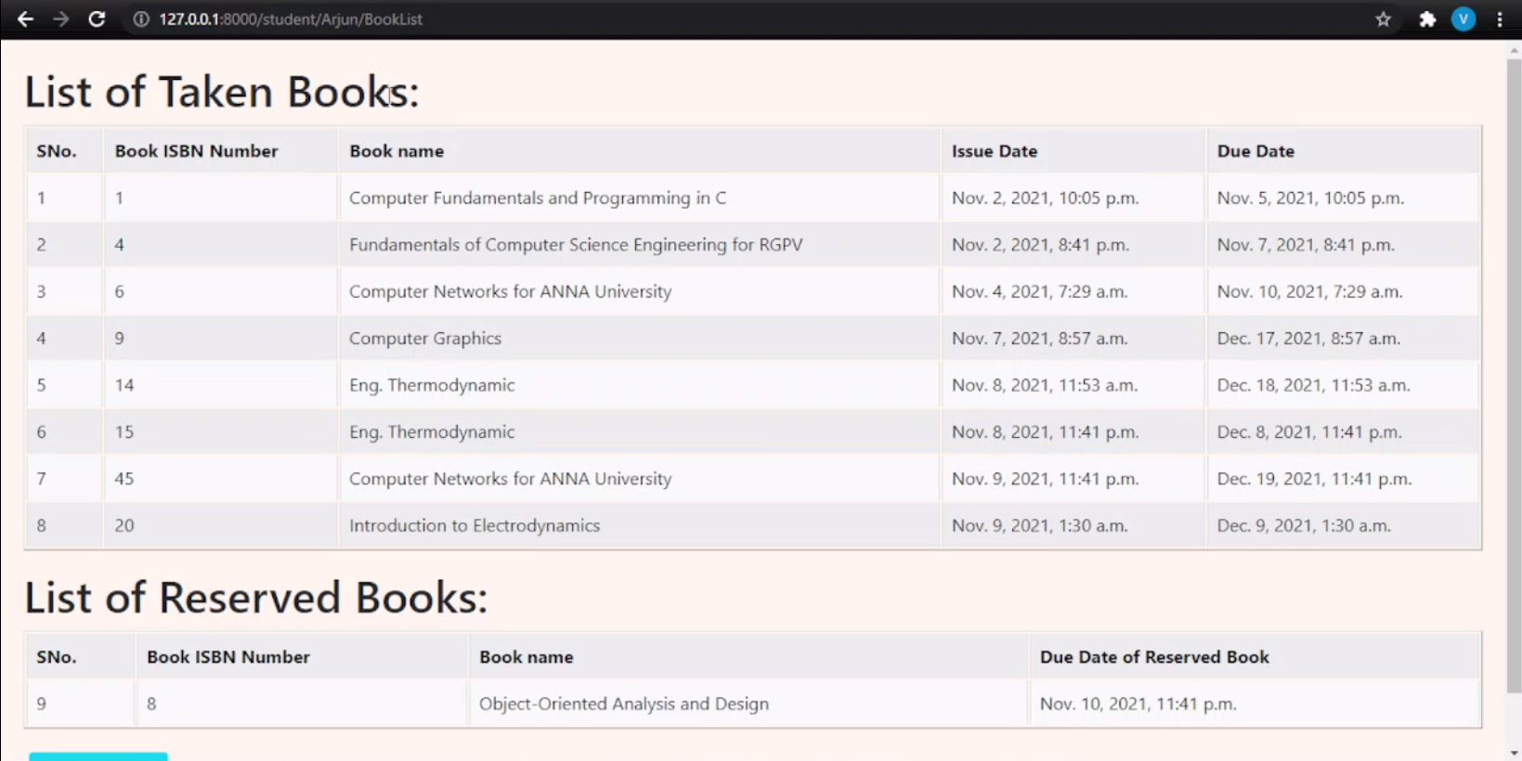

Slide 39
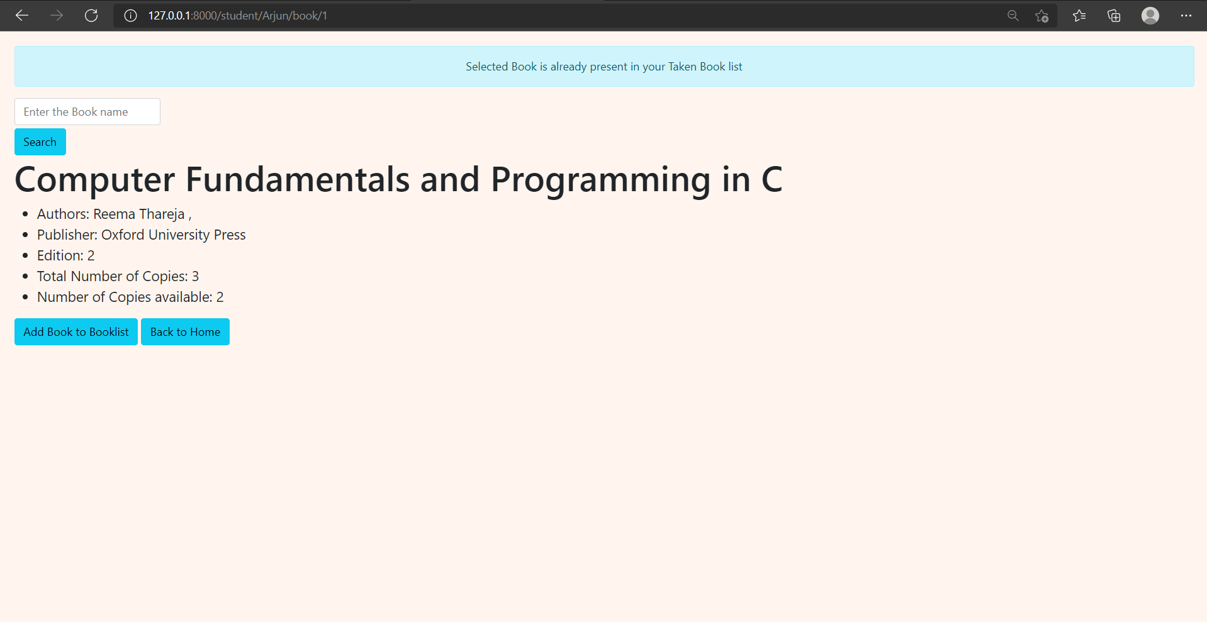

Slide 41
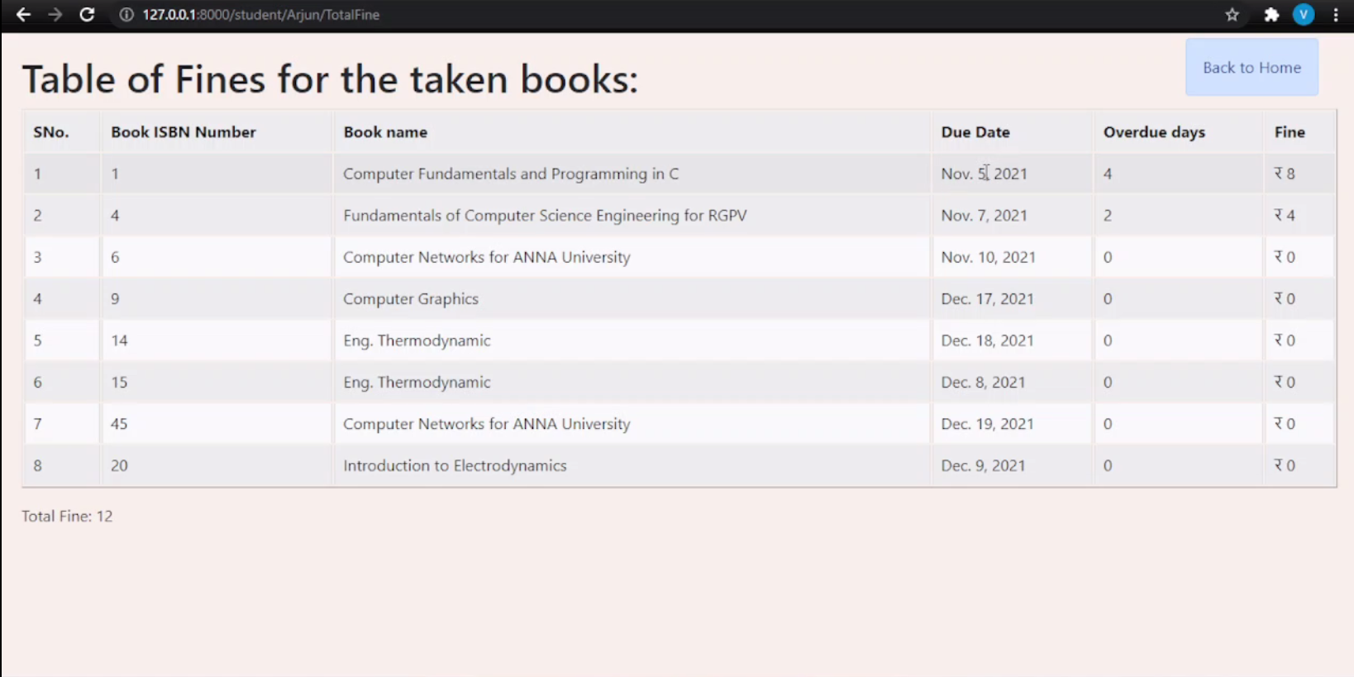

Slide 43
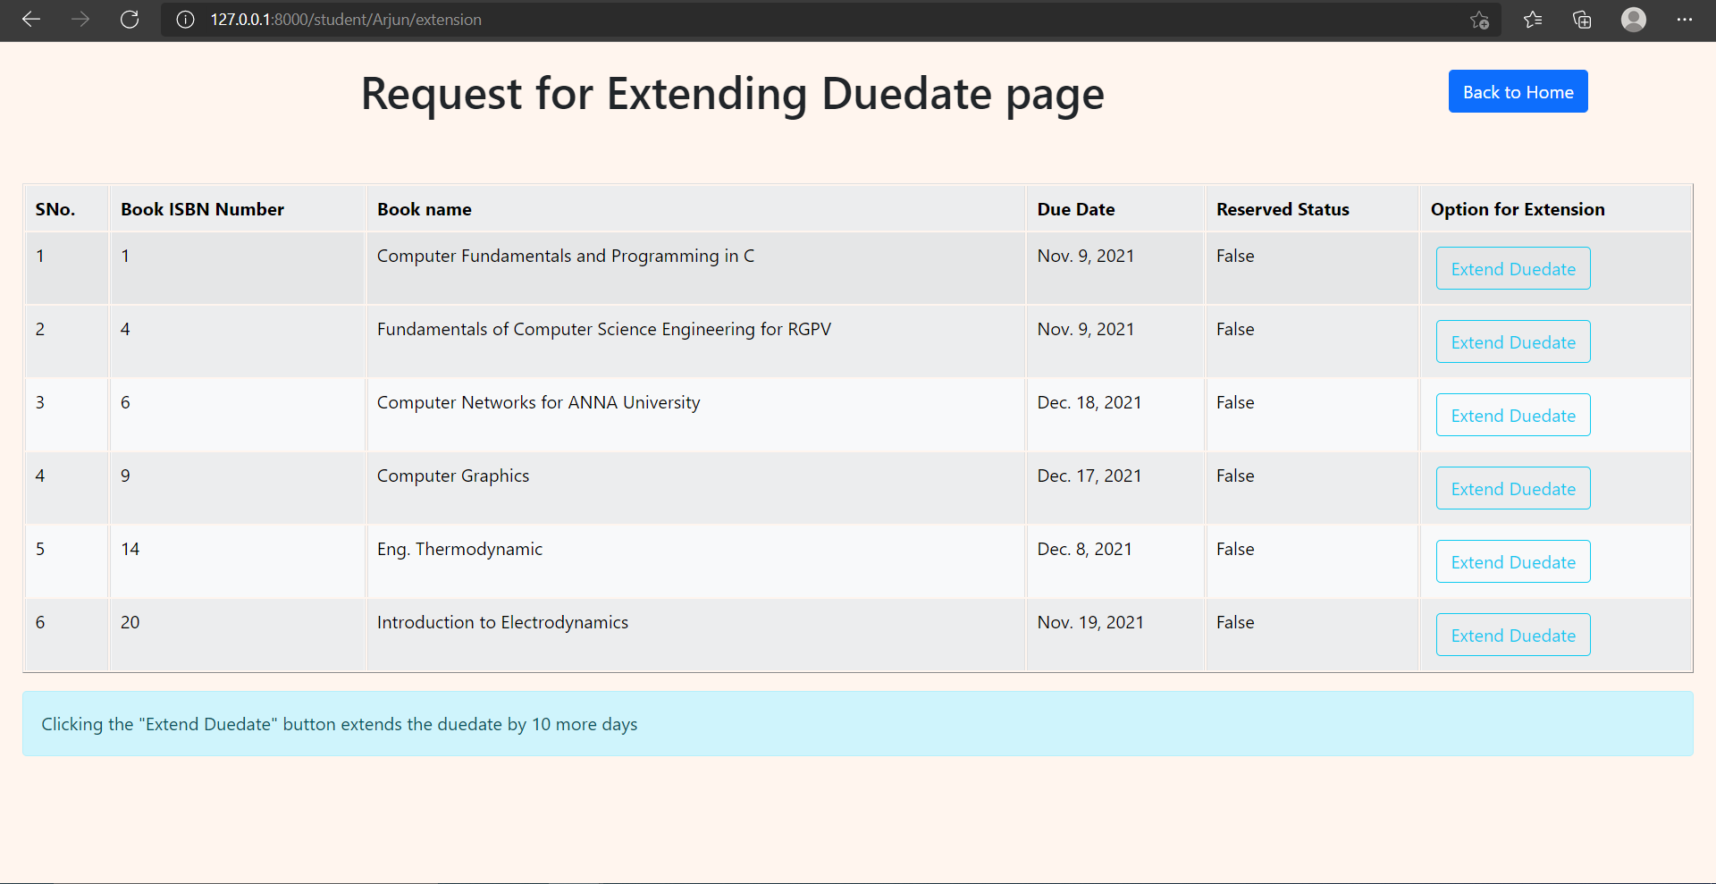

Slide 44
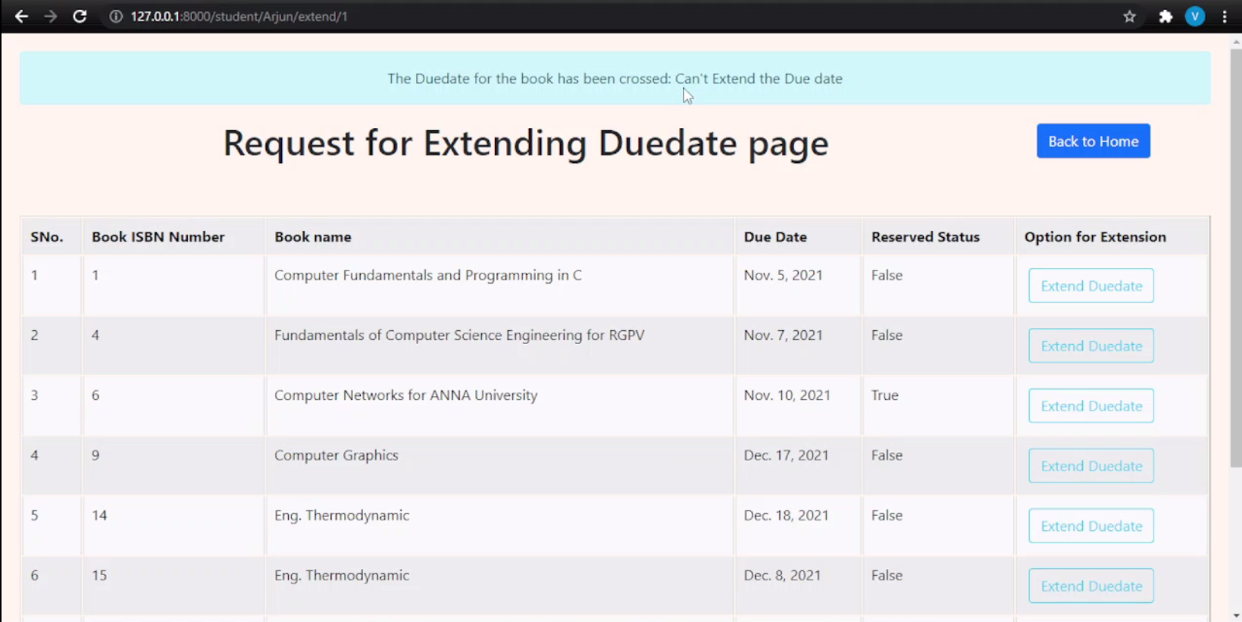

Slide 45


Slide 46
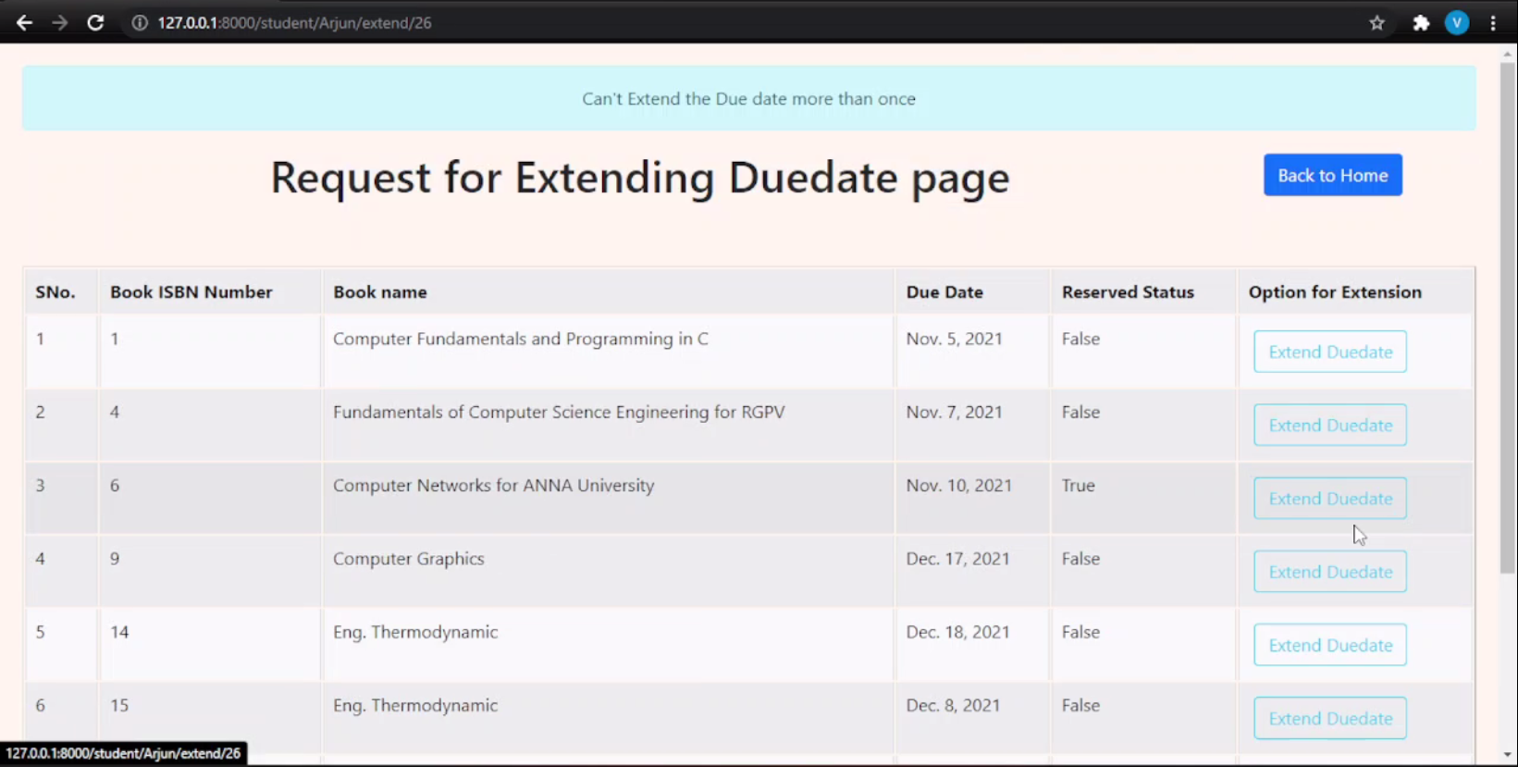

Slide 47
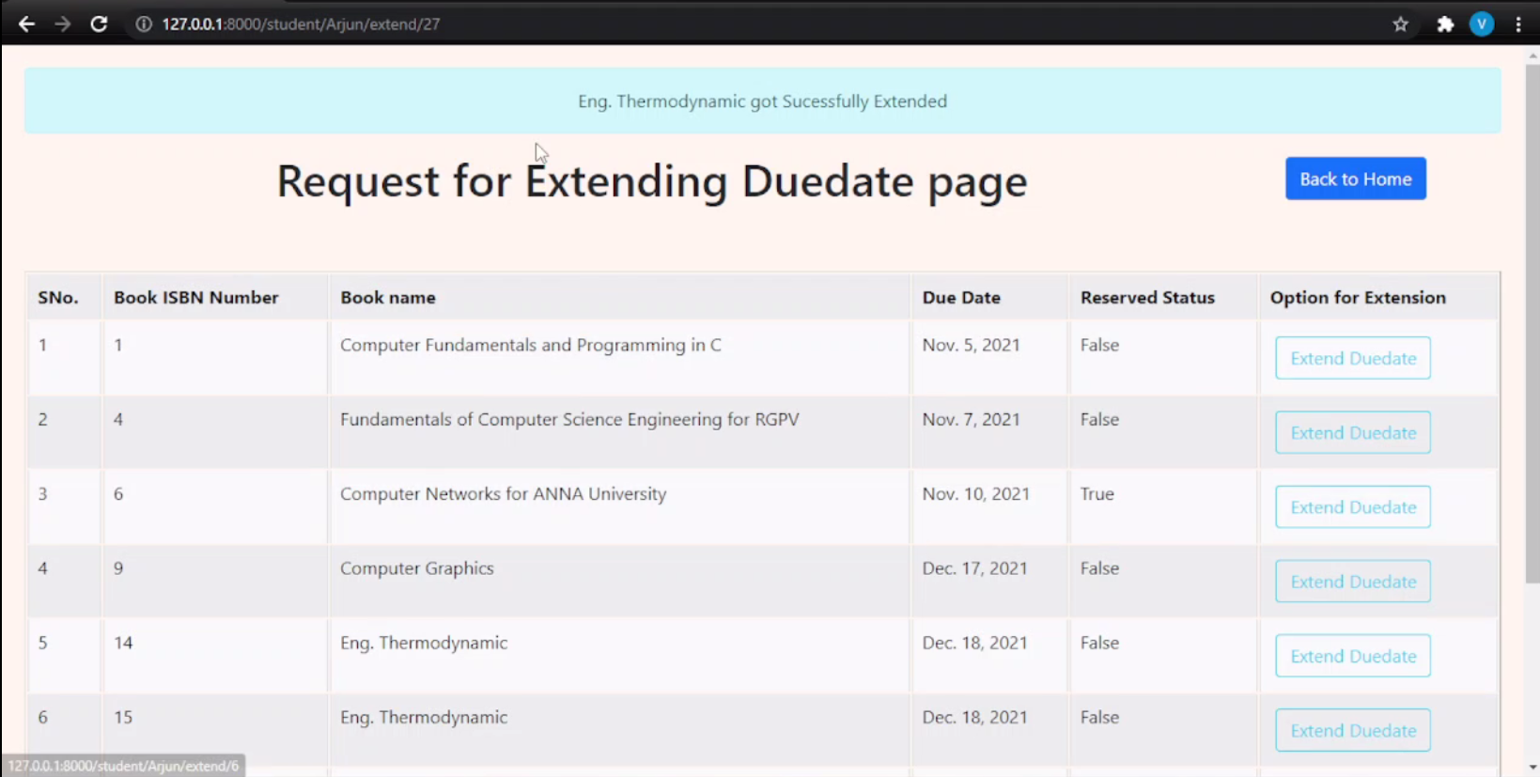

Slide 49
LIBRARIAN HOME PAGE

Slide 50
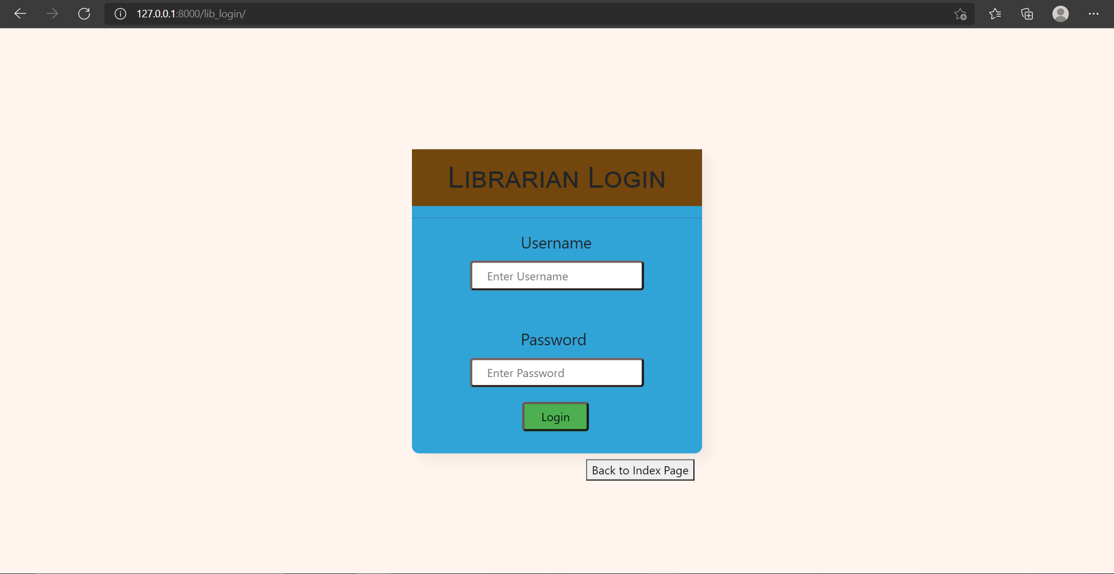

Slide 51
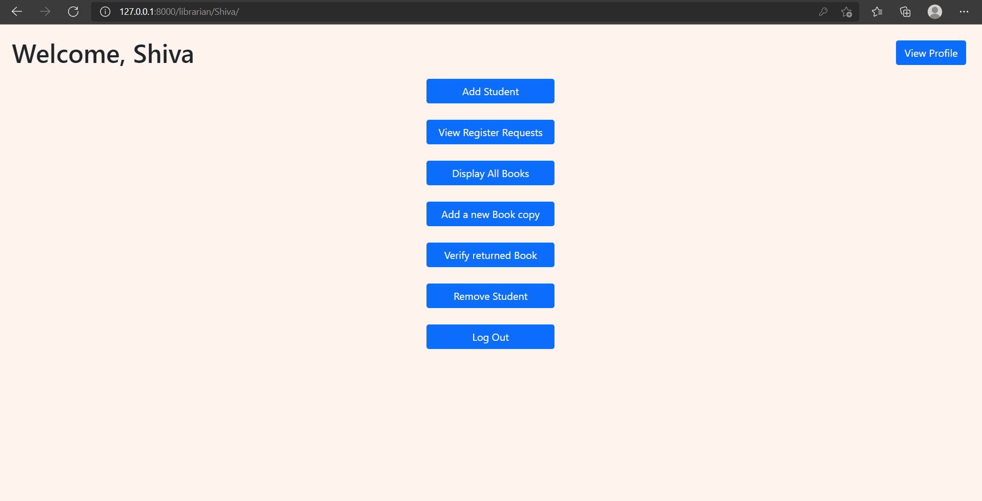

Slide 52
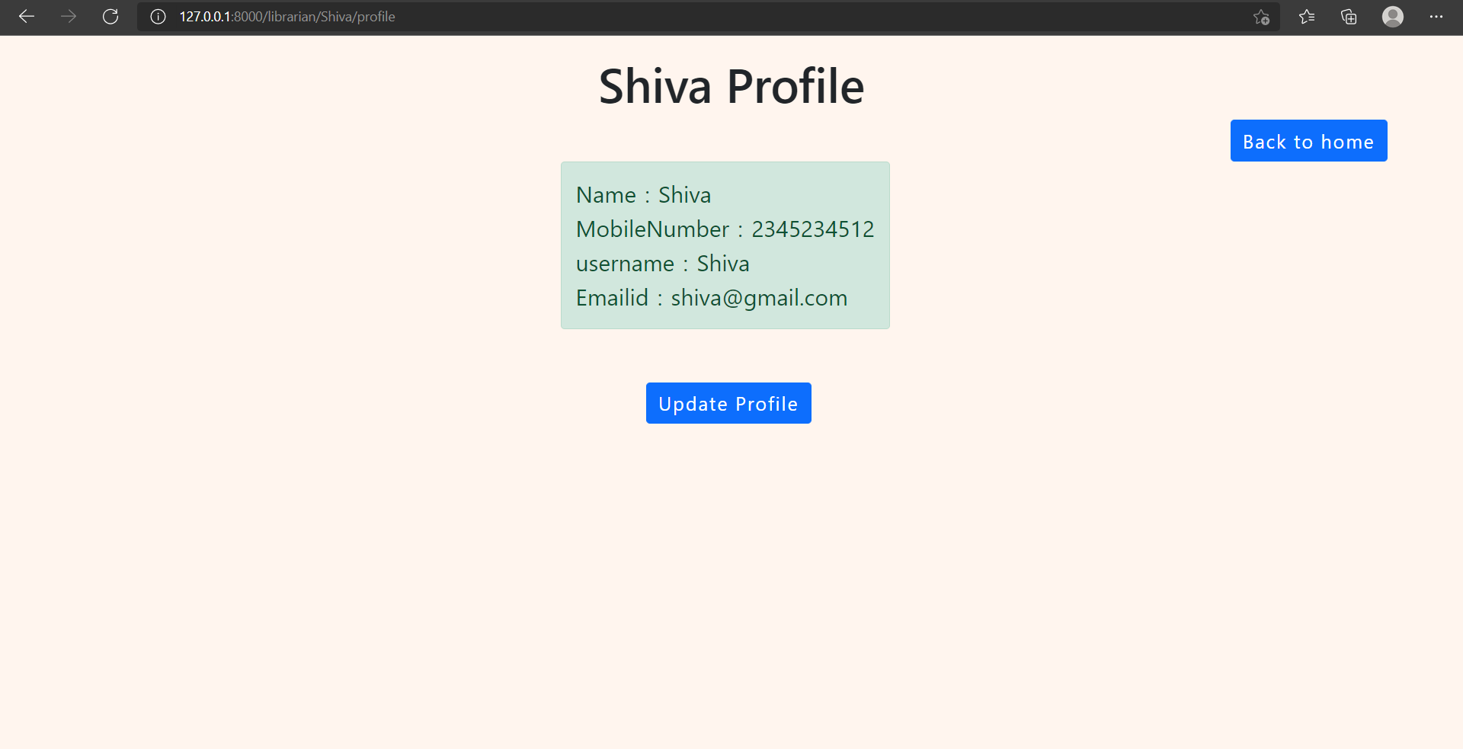

Slide 53
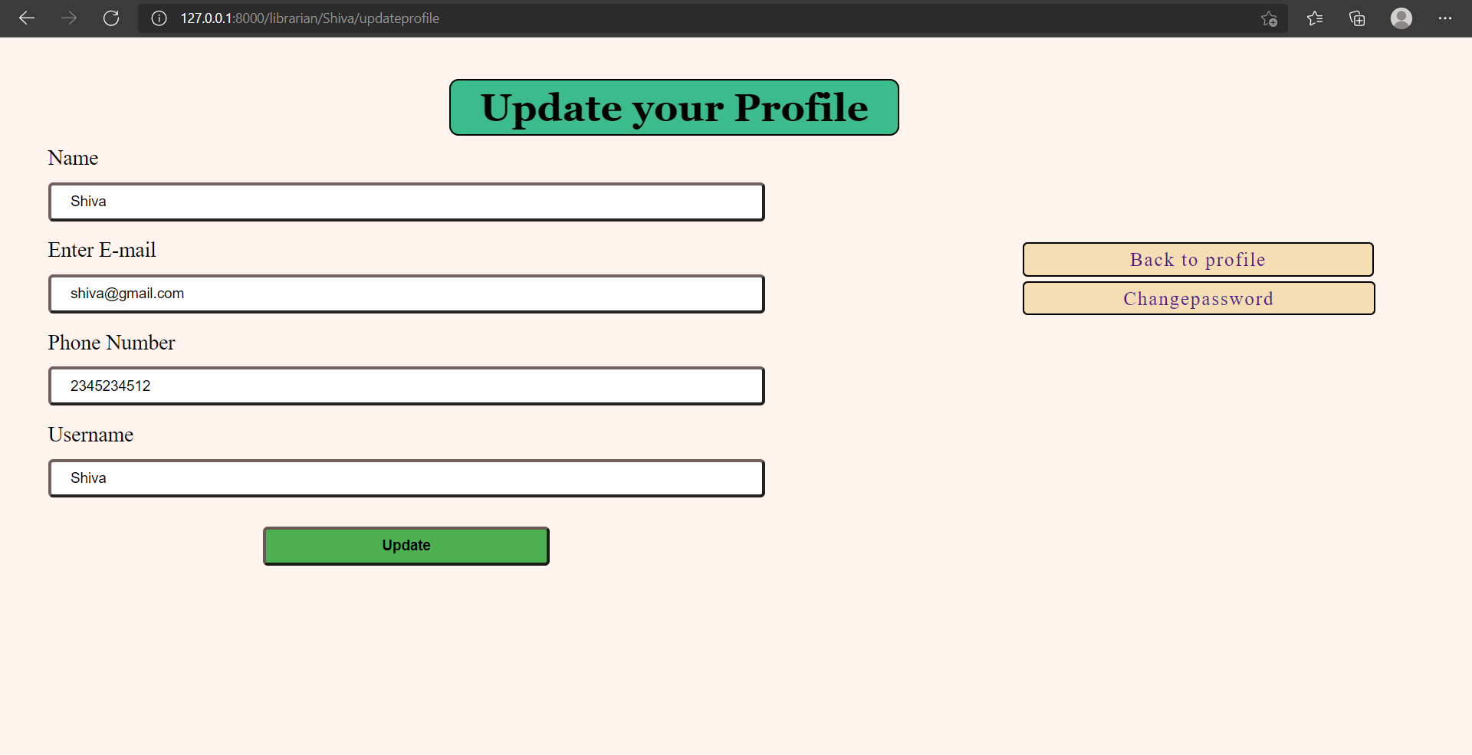

Slide 54
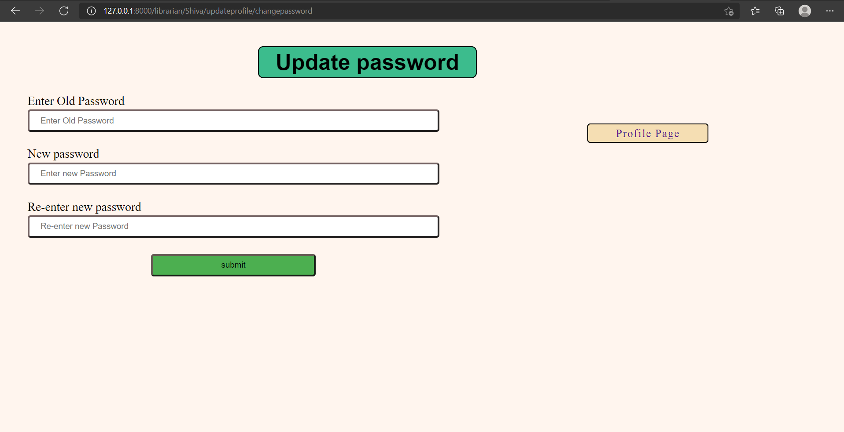

Slide 55
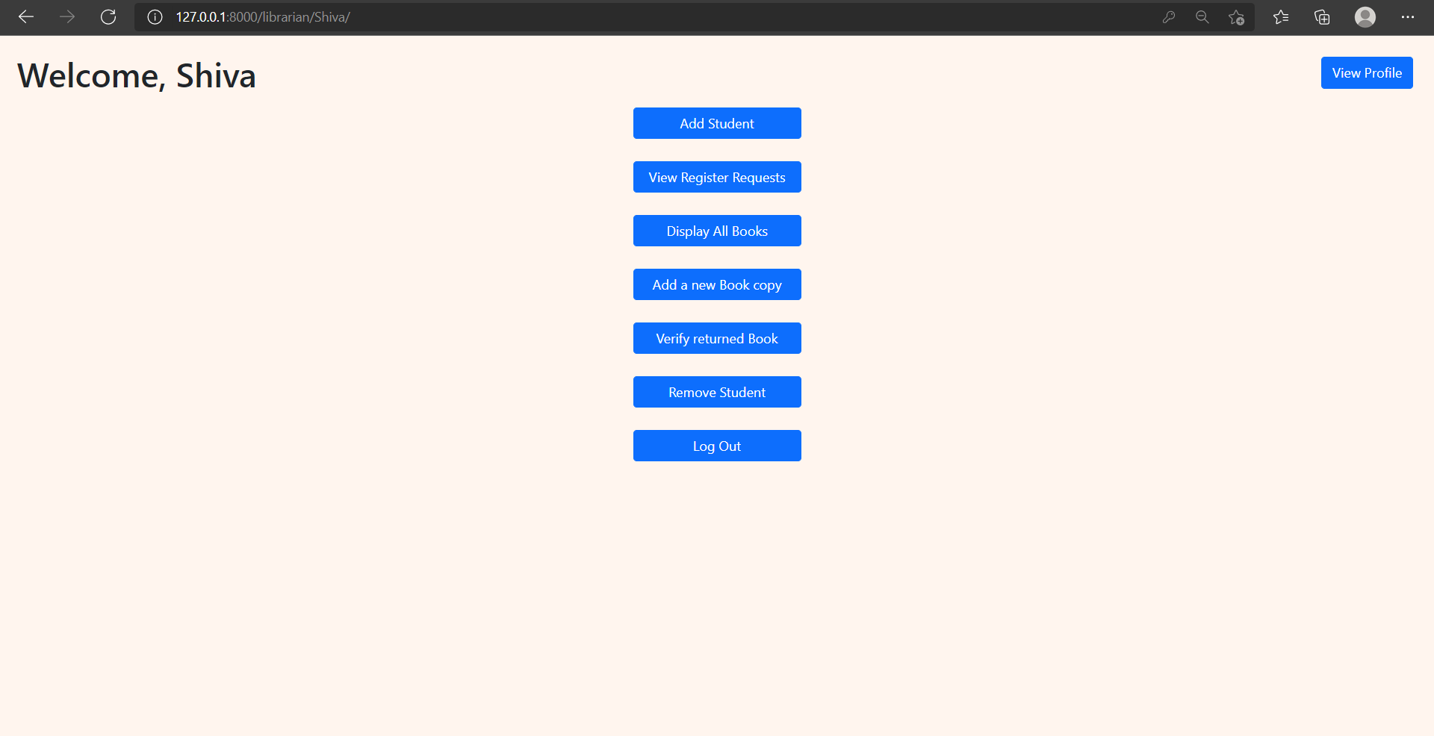

Slide 56
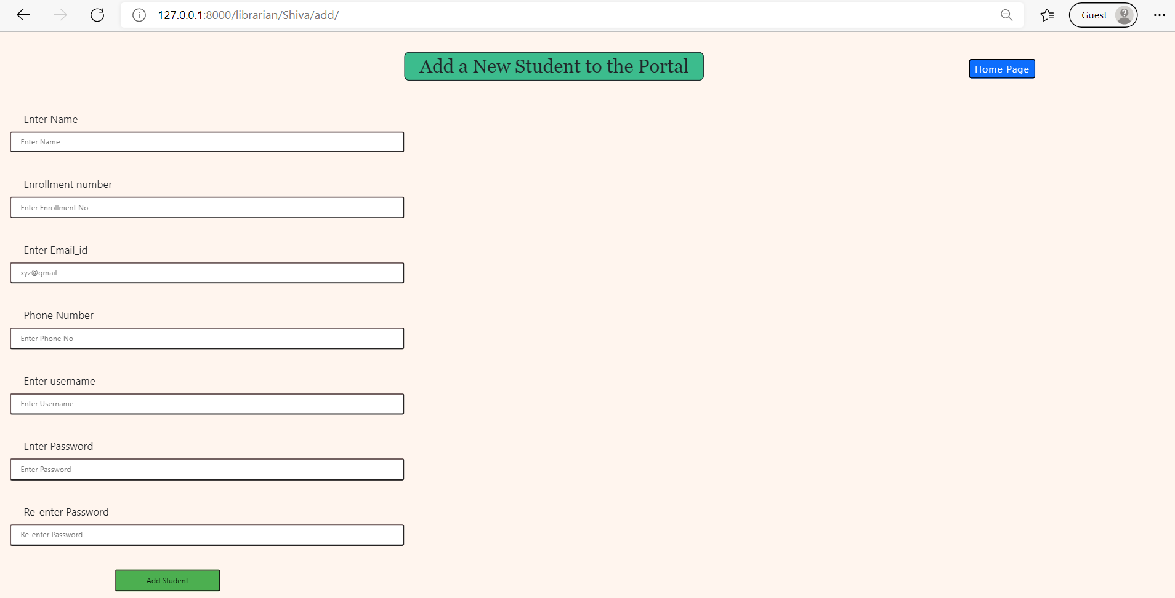

Slide 57
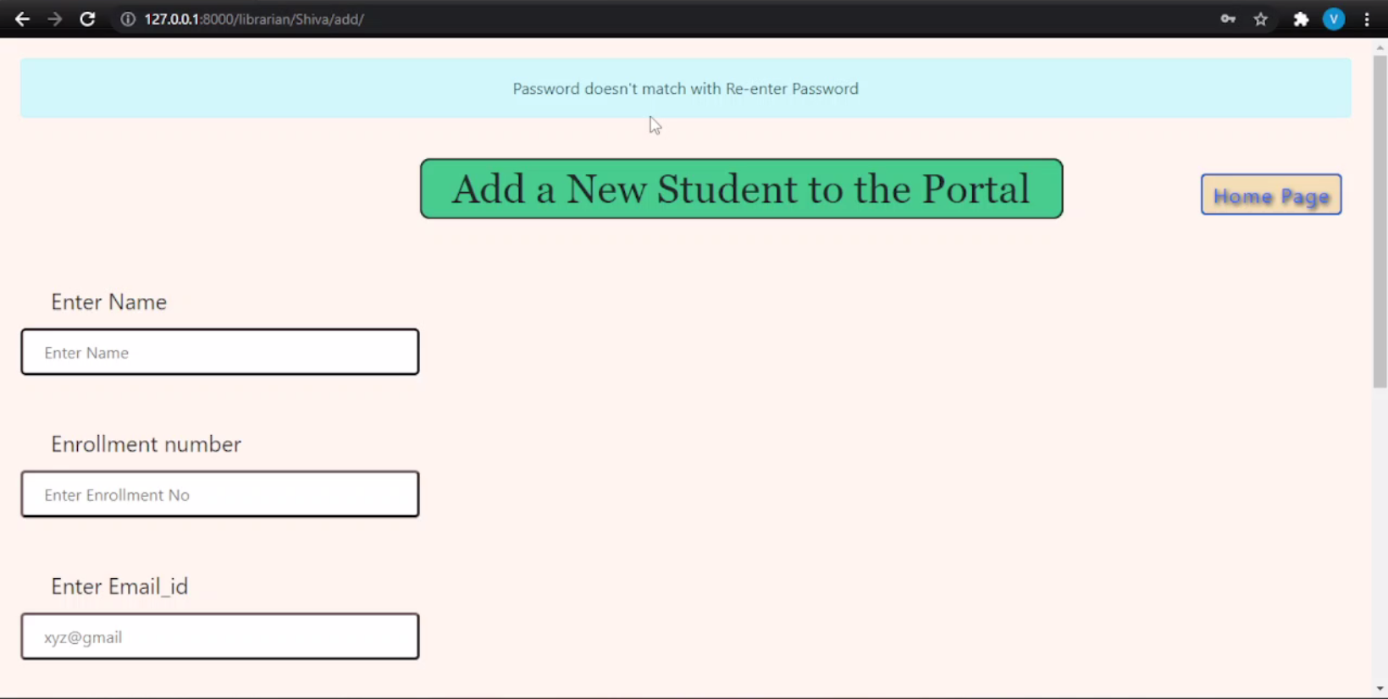

Slide 58


Slide 59
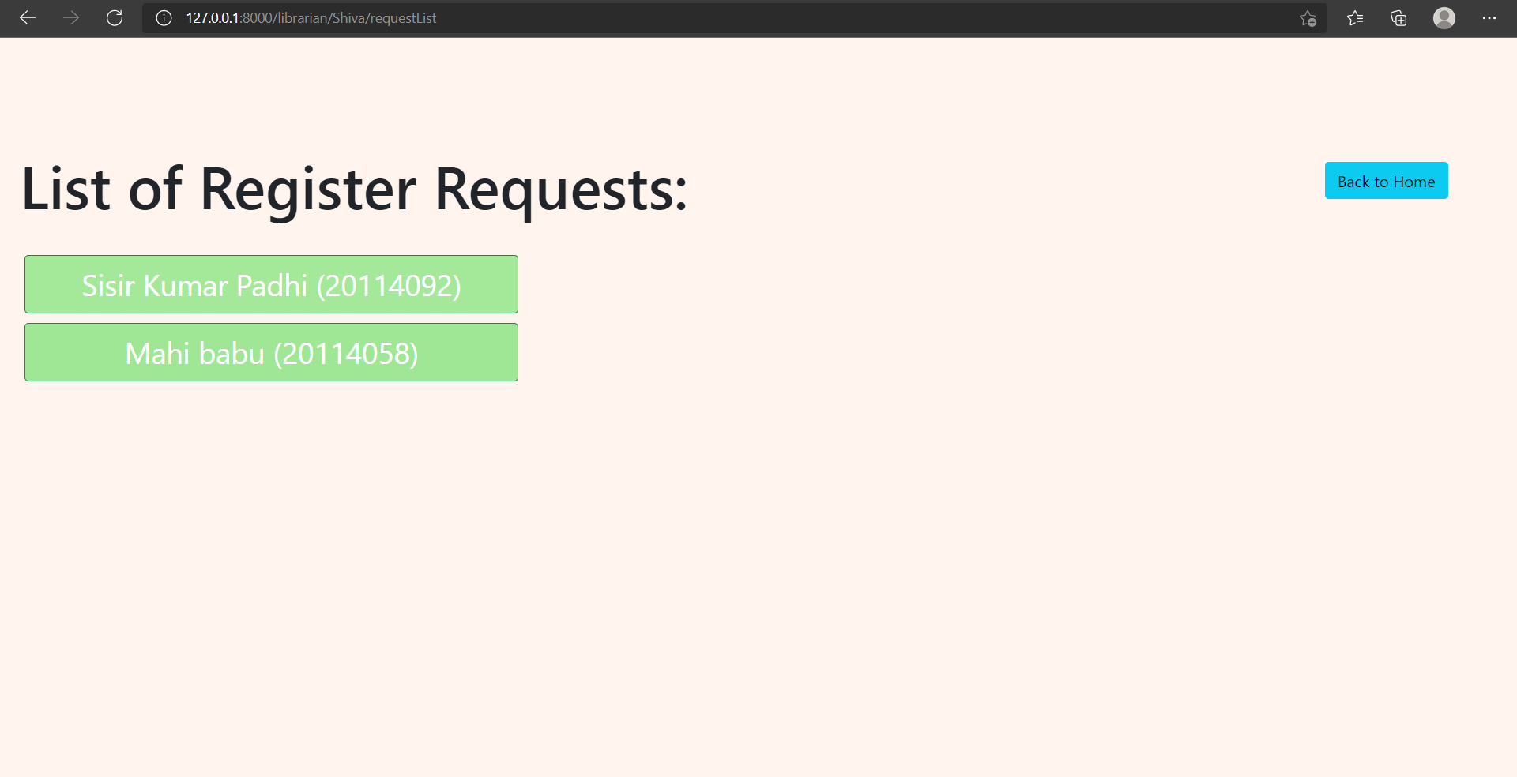

Slide 60
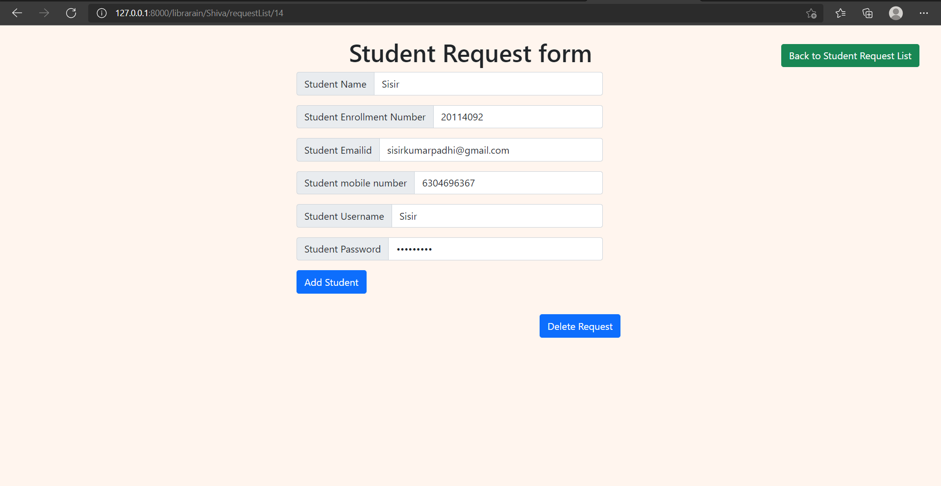

Slide 61
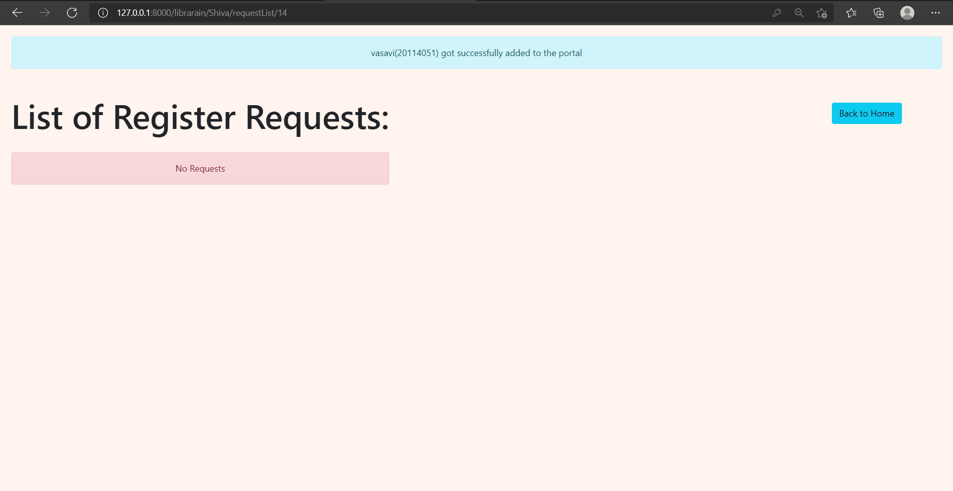

Slide 62
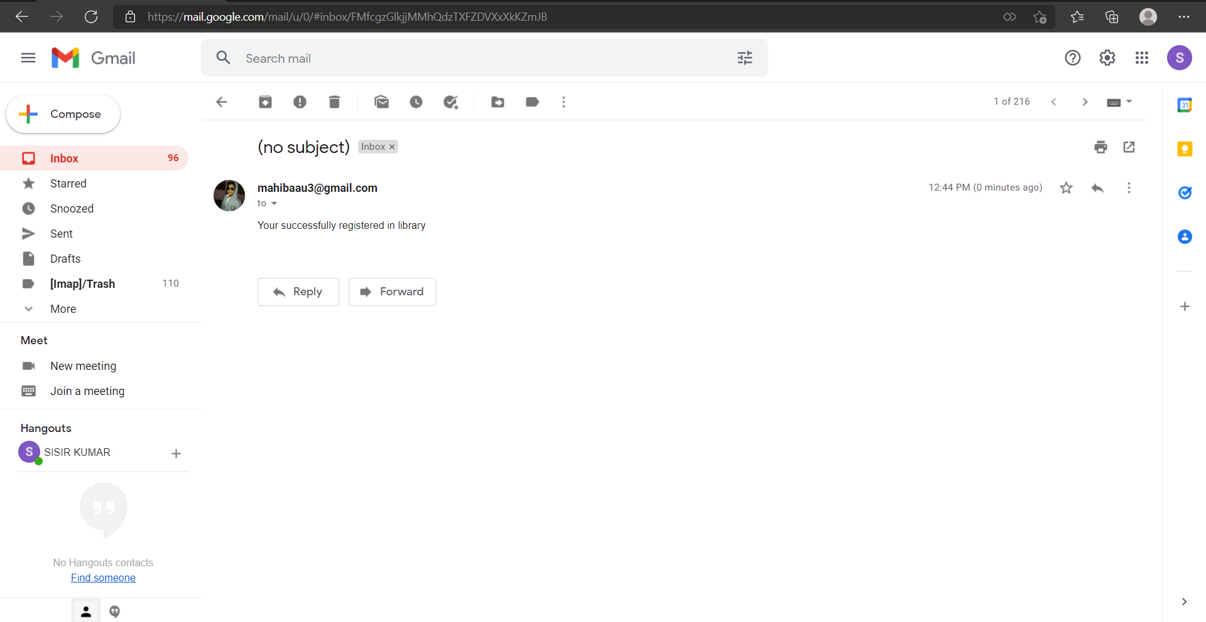

Slide 64
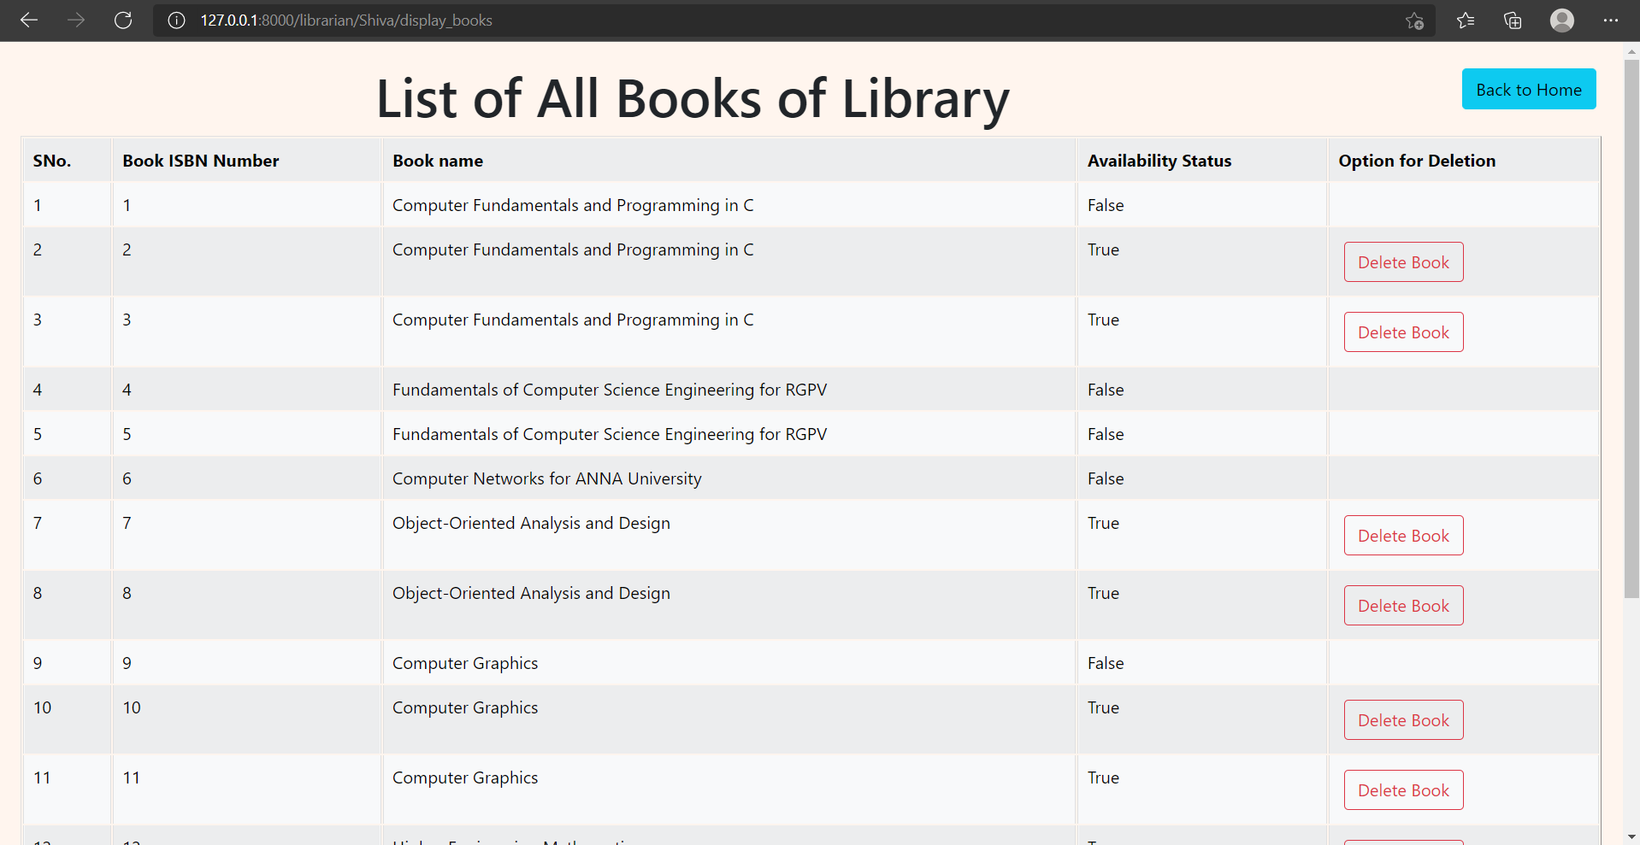

Slide 65
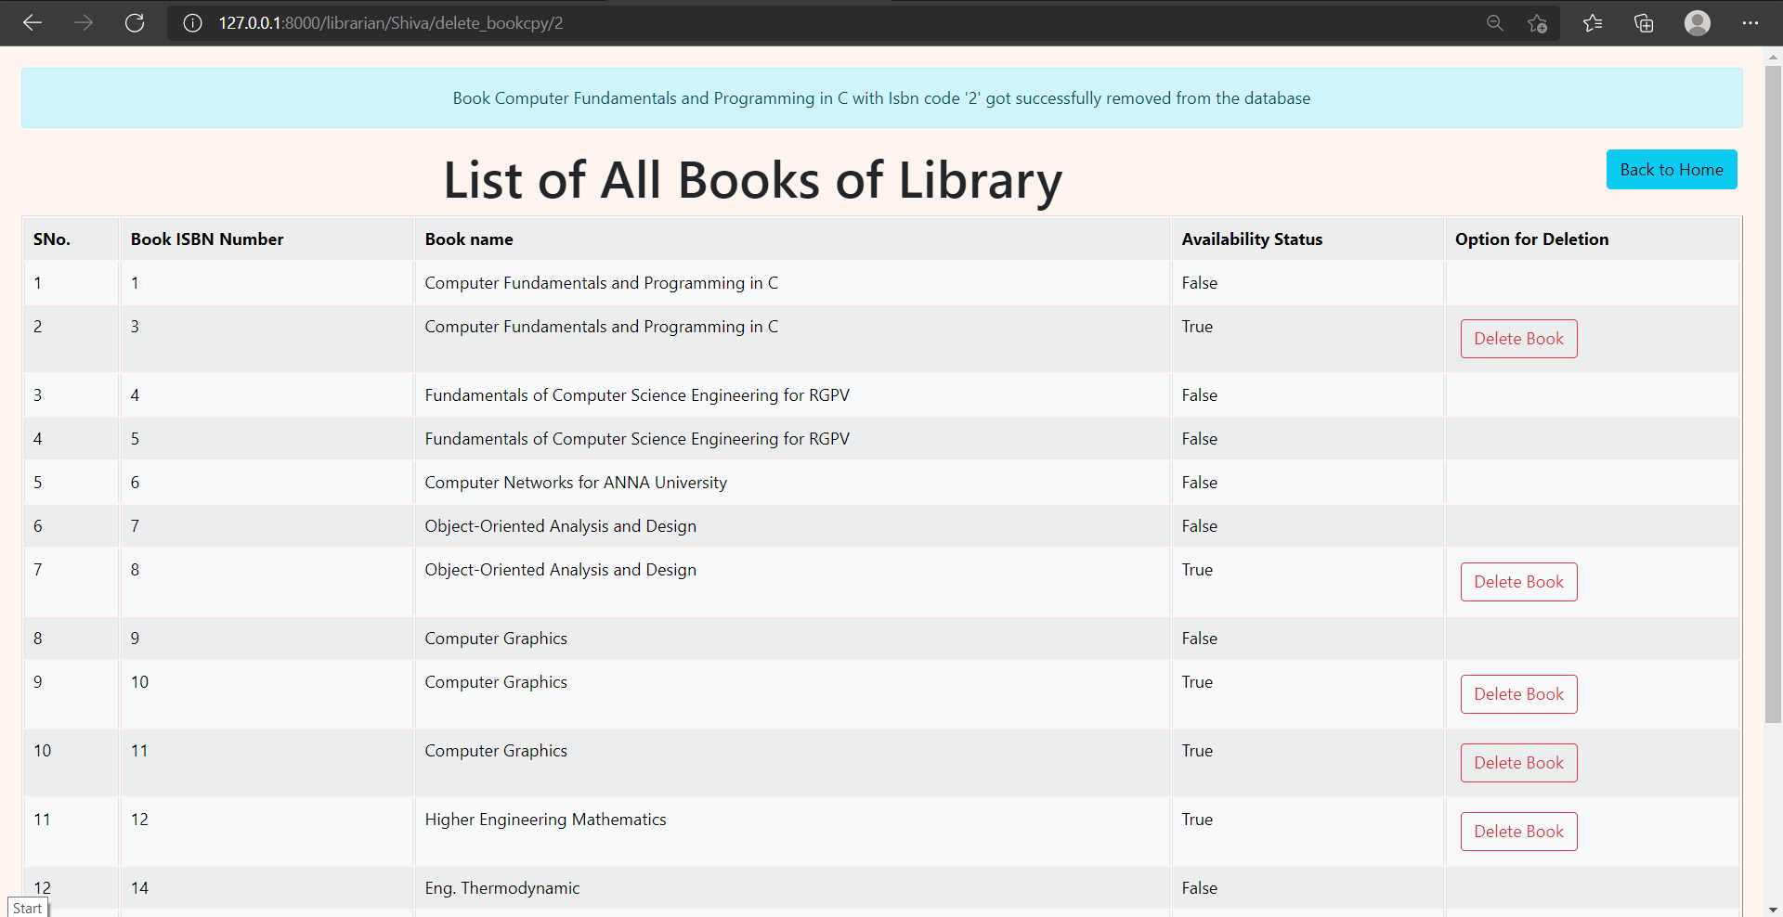

Slide 67
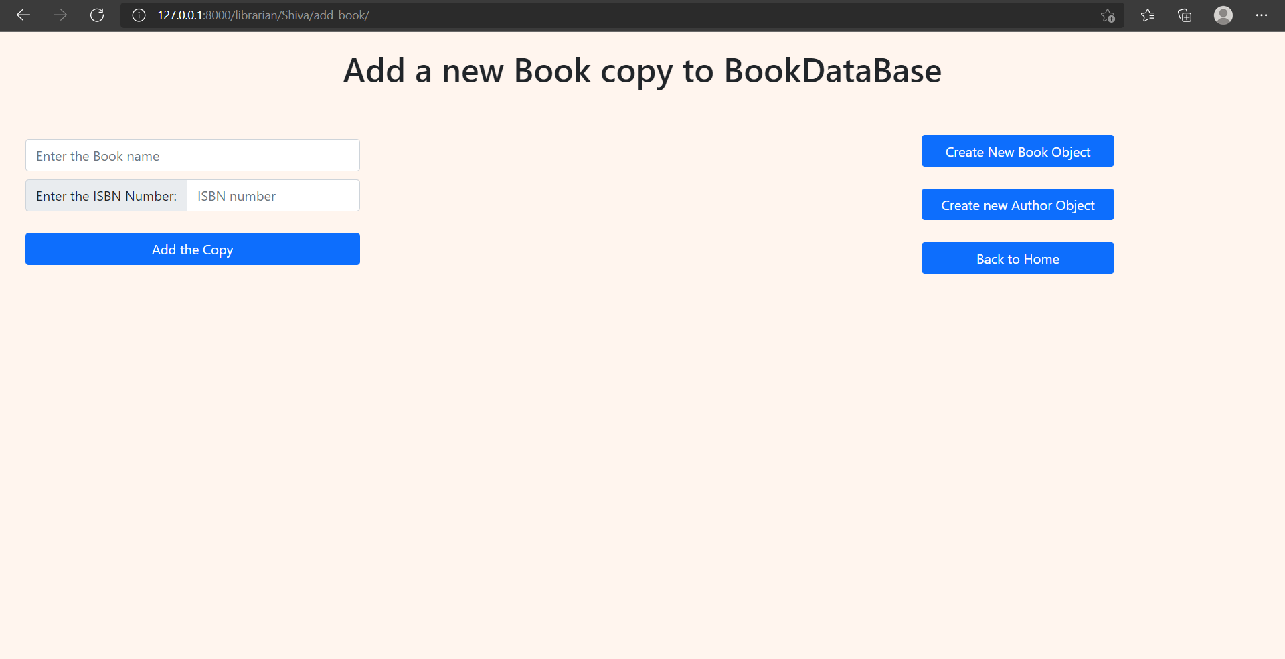

Slide 68
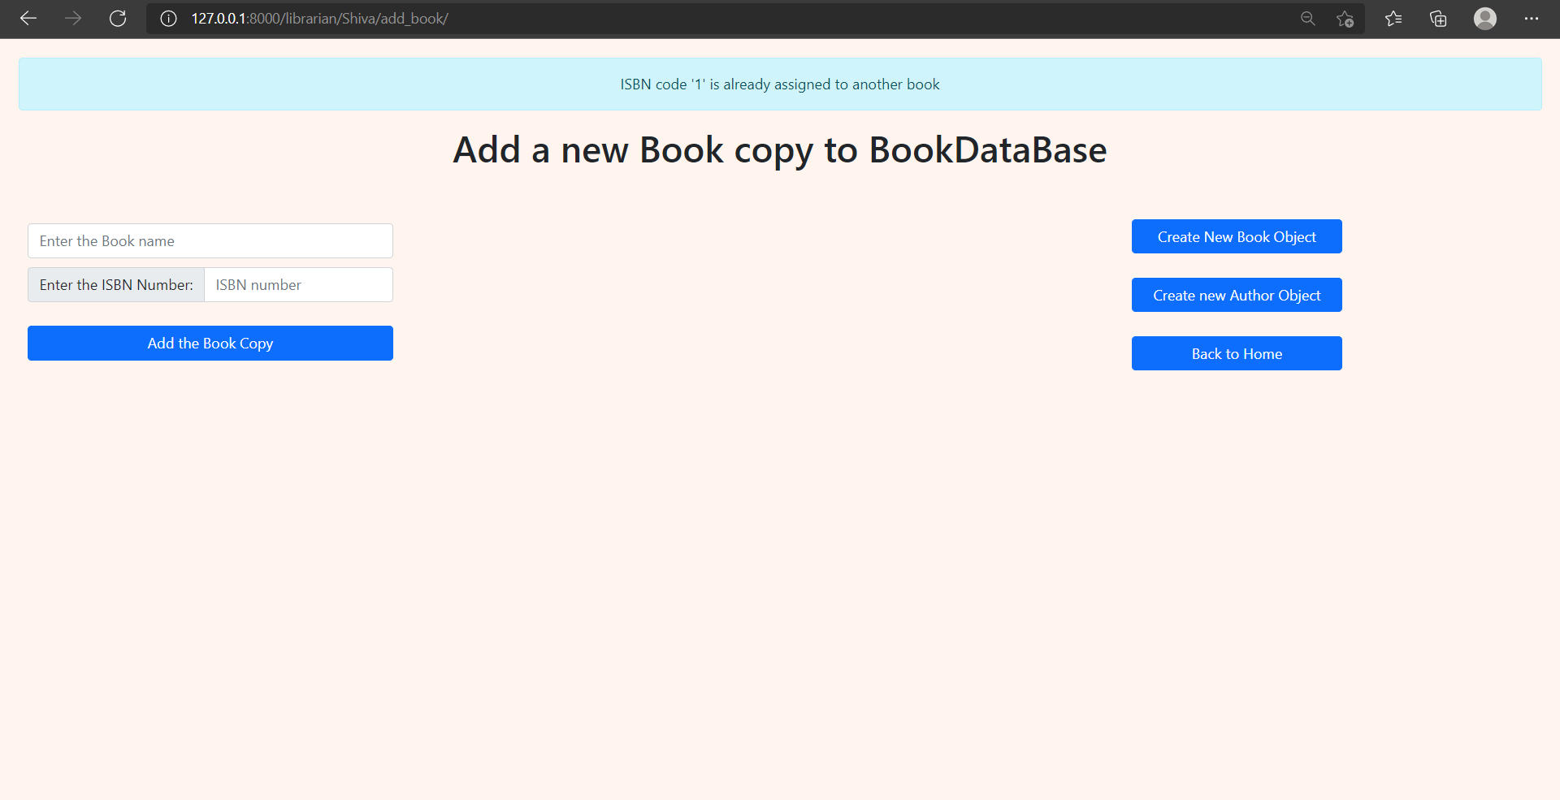

Slide 69
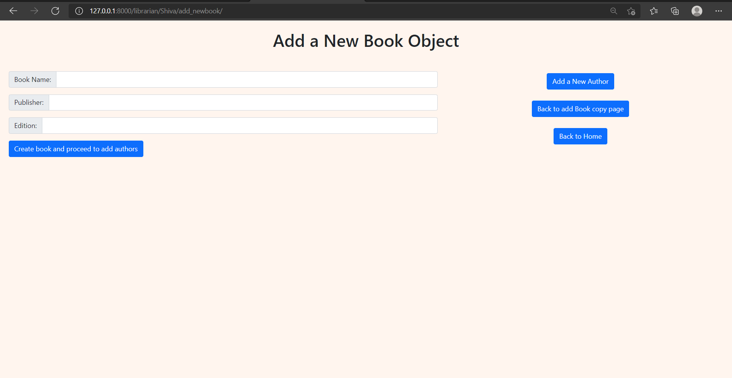

Slide 70


Slide 72


Slide 73


Slide 74


Slide 75


Slide 77


Slide 78


Slide 79


Slide 81


Slide 82


Slide 83


Slide 84
Applications of the Project
Student can add required books or reserve a book if books not available
Due-date extension feature is available for the books which are not reserved
Addition/Removal of student by a librarian
Student can directly send request for registration through website
Librarian can add/modify/remove a book and it’s details from booklist

Slide 85
References
https://www.w3schools.com/python/
https://www.youtube.com/playlist?list=PLhQjrBD2T380xvFSUmToMMzERZ3qB5Ueu
https://www.w3schools.com/html/default.asp
https://www.w3schools.com/bootstrap5/index.php
https://www.w3schools.com/css/default.asp
https://www.w3schools.com/git/
https://www.w3schools.com/python/

Slide 86


